Slide 1
ACADEMY OF ORTHOPAEDIC PHYSICAL THEARPY (AOPT), APTA
SPECIAL INTEREST GROUP LEADERSHIP ORIENTATION

Slide 2
BYLAWS, STRATEGIC PLAN AND POLICIES
Bylaws and the AOPT’s 3-year Strategic Plan can be
found beneath the following web site drop-down menu:
(Orthopt.org > Governance)
Policies: A full description of Board of Director duties, as well as policies for each Committee can be found on the Academy’s website. Included on this page are the SIG/EIG Rules of Order. Note: these are all working documents, reviewed (and updated) annually.
(Orthopt.org > Governance > Section Policies)

Slide 3
SIG PURPOSE
Provide educational programming to Academy membership
Serve the Academy as an educational and practice resource for members
Develop and recommend practice standards and terminology
Identify changes in legislation, regulation, and reimbursement issues at state and national levels
Identify and provide resource contacts and materials to accurately share practice information and address areas of concern related to the SIG domain
Foster credible research within the SIG domain in conjunction with the AOPT Research Committee to promote both scientific foundation and interdisciplinary study within the SIG domain

Slide 4
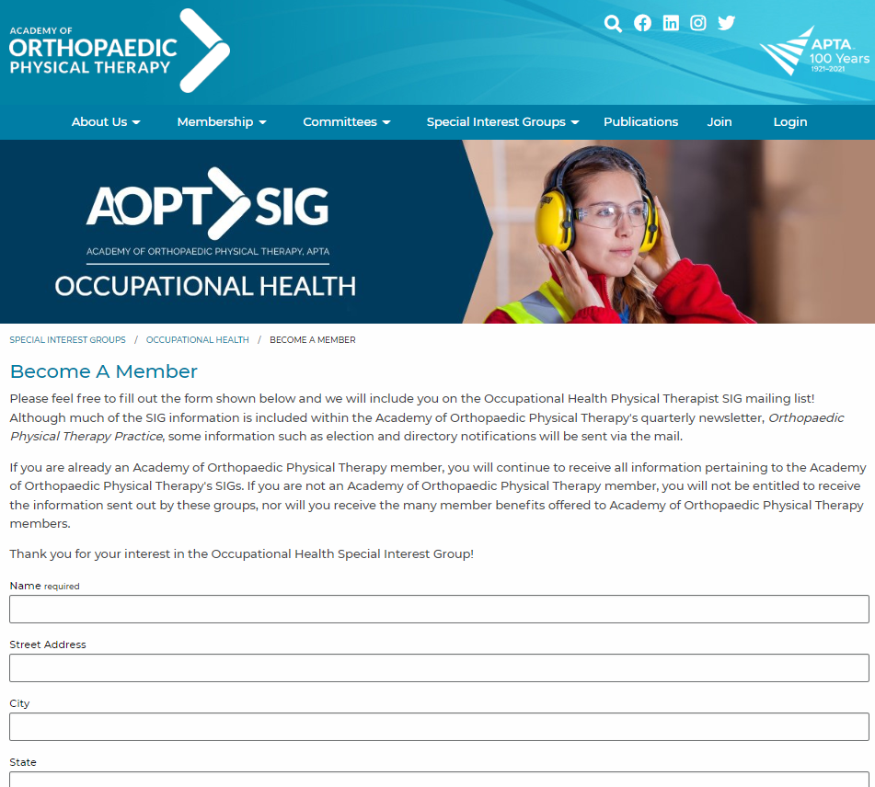
SIG MEMBERSHIP
Qualifications for Membership
Any AOPT Member who is in good standing can become a member of any or all of our SIGs.
Admission to Membership
Any Academy Member who desires to become a SIG member shall submit a request to the AOPT office either via the online form or by contacting the AOPT office.
The membership form can be found by going to orthopt.org > Special Interest Groups > the SIG you would like to join > Become a member.
There is no cost to joining any or all of the SIGs.

Slide 5
COMMUNICATING WITH SIG MEMBERSHIP
E-mail blasts
SIG leadership has the opportunity to communicate with their applicable memberships as often as they
would like.
The information to be distributed is submitted to the Assistant Executive Director for review. The Assistant Executive Director then forwards the e-blast to the applicable BOD Liaison for review and approval. Examples of current e-blasts include:
OHSIG: Literature Review and “News from your OHSIG” (quarterly)
PASIG: “Citation Blast” (monthly)
Facebook “private pages”
Creation of a SIG Facebook page is coordinated through the PR Committee Liaison.
Individuals wishing to be “friends” of the page will be invited or will need to request to be added.
Posts need to be monitored very frequently. Advertisements of any kind will not be allowed.
Website
Information can be added to the SIG websites after AOPT BOD approval. Requests for website additions should be sent to the Assistant Executive Director.

Slide 6
COMMUNICATING WITH SIG MEMBERSHIP
Member’s E-Mail Addresses
Per APTA and AOPT policy, e-mail addresses cannot be sold nor provided to any member, regardless if they are a part of the Academy or SIG Board of Directors. All correspondence that is sent out via mass e-mail will be distributed through the AOPT office.
Membership Lists
Membership lists containing first and last names, city, and state can be provided to SIG leadership.

Slide 7
SPECIAL INTEREST GROUPS (SIG)
SIG Officers consist of a President and a Vice President/Education Program
Chair
Have an annual budget of $3750
Provide a proposal for 2 hours of educational programing each year at CSM or a Annual AOPT Meeting as requested by the Education Committee Chair
Conduct an annual SIG Membership Meeting at CSM
Hold at least 2 conference calls per year to conduct SIG business.

Slide 8
GOVERNING BOARD
The SIG Governing Board consist of:
President (elected by SIG membership)
Vice-President/Education Chair (elected by SIG membership)
AOPT Board of Directors Liaison
All three members will attend every meeting of the SIG Governing Board, including conference calls and face-to-face meetings
The Nominating Committee will consist of:
Chair
2 Members
Each year, the SIG will elect one Nominating Committee Member. The elected
individual will serve 2 years as a member, and on their third and final year on
the committee, will act as Nominating Committee Chair.

Slide 9
REQUIRED ACTIVITIES OF SIG OFFICERS
President
Attends Academy Membership Meeting & Board of Directors/Committee Chairs/SIG
Presidents meeting at CSM annually
Staffs the booth at CSM for a minimum of 2 hours each year
Represents the applicable SIG at the Fall AOPT Strategic Planning meeting every 5 years as well as other Academy meetings when requested by BOD
Provides a written report on SIG activities one month prior to Fall BOD meeting, Academy BOD meeting at CSM, and July BOD meeting
Submits a SIG informational update and/or article to OPTP at least 2 times per year
Provides a report to the BOD for review at the CSM Board Meeting during their third year of Presidency, indicating how the SIG has fulfilled the six purposes documented for SIGs

Slide 10
REQUIRED ACTIVITIES OF SIG OFFICERS
Vice President/Education Chair
Provides a proposal 2 hours of educational programing each year at CSM or at the Annual Orthopaedic Meeting if requested by the Academy’s Education Chair
Works with the Academy’s Education Committee Chair to plan CSM or Annual Orthopaedic Meeting programming
Serves as moderator of the applicable SIG’s education session at CSM
Can only serve as a presenter for one annual CSM or Annual Orthopaedic
Meeting education session during each three-year term

Slide 11
ELECTION PROCESS/TERMS OF OFFICE
Each year the Assistant Executive Director will send a “Call for Candidates” to the applicable SIG membership beginning in June, and reminders will continue to be sent until the Slate of Candidates is closed in early-September.
The Assistant Executive Director will inform each SIG’s Nominating Committee, copying the SIG‘s Board Liaison, of the upcoming election process and deadlines, and will continue to communicate with the Nominating Committee throughout the election period.
The SIG’s election period will coincide with the AOPT’s election period. SIG candidate profiles, statements, and voting ballot will be included with the AOPT’s slate and ballot.
Each position is a 3-year term; no person shall be elected to serve more than two (2) full consecutive terms in the same office; no person shall serve more than four (4) complete consecutive terms on the SIG Board of Directors.
Standing committees may be formed, however, the Chair positions will not be elected, but instead will be appointed. Names and CVs for appointees will be brought forth to the SIG leadership and AOPT Board Liaison for approval.

Slide 12
BOARD, COMMITTEE, SIG POLICY - DISMISSAL
Grounds for dismissal of a Board or Committee member include but are not limited to: 1) noncompliance with Academy standards, policies, positions, guidelines or Code of Ethics; 2) failure to perform assigned tasks; 3) failure of the member to attend 75% or more of the meetings; 4) lapsed or dropped membership; 5) disciplinary action by a licensing board.
If a vacancy in a Board or Committee arises either through a resignation or dismissal, it will be filled in accordance with the guidelines for appointment of a Board or Committee member.

Slide 13
SIG BUDGETS - $3,750 ANNUAL BUDGET
Does not roll over into the next year.
If a SIG utilizes the $3750 allocated budgeted funds, all other expenses, based on BOD approval, will be taken out of the SIG’s
encumbered funds.
If no encumbered funds exist, special approval is needed by the AOPT Board of Directors for additional funds.
SIG budgets will be submitted to the Finance Committee when requested by the Executive Director.
Each SIG will appear in the Academy budget as a program and be managed in the same manner as other budgetary programs.
Budgeted expenses will be reimbursed with proper documentation.
Copies of expenses paid will be sent to SIG Presidents quarterly.
SIG President and Vice President will be reimbursed for airfare, two days per diem (meals & hotel), and conference registration for attendance at CSM or the Annual Orthopaedic Annual Meeting.
All CSM or Annual Orthopaedic Meeting expenses incurred by the SIG, is paid for by the Academy if kept within the allocated
$600 budget. Expenses exceeding the $600 budget will need approval from the AOPT BoD to be drawn from the SIG’s encumbered
funds, if these funds exist.
Speaker reimbursement will follow the Academy’s guidelines for Speaker Reimbursement listed in the AOPT Education Policy.

Slide 14
SAMPLE SIG BUDGET

Slide 15
SIG ENCUMBERED FUNDS
‘Encumbered Funds’ are funds that the Finance Committee will maintain in a secure, no risk investment fund and will be available for legitimate purposes for SIGs consistent with SIG policies, AOPT Bylaws and current Strategic Plan.
Funds not used in a calendar year will be rolled over to the following year.
SIGs may budget use of their encumbered funds through the normal budgetary process.
SIGs may also request to access encumbered funds by written request from the SIG President to the AOPT Office.
It should include, the type, amount and purpose of the expense and will be submitted to the Executive Director.
Money is earned for encumbered funds from CSM Pre-conference course profit, off-site educational programming, and SIG co-sponsored ISCs profit
A 50/50 split of all net profits will occur for the above-mentioned possible offerings.

Slide 16
SIG ENCUMBERED FUNDS
The AOPT may access the SIGs encumbered funds for non-SIG purposes if fiscal necessity arises.
If a SIG were to become an EIG, the existing funds would be available for five years.
If at the end of five years the EIG has not converted back to an SIG, the funds would be returned to the AOPT’s budget to fund research and advocacy issues.
If a SIG were to cease to exist and did not become an EIG, the SIG membership would be asked if funds should be used to fund research and/or advocacy issues.
If the applicable SIG membership could not come to a decision, the funds would be placed in the AOPT’s general account.

Slide 17
REIMBURSEMENT POLICY/FORM
Reimbursement for budgeted travel by the Academy staff, members, invited speakers or consultants will be made as follows:
Hotel reimbursement will not exceed the single room rate, plus taxes at the convention hotel(s).
Airfare reimbursement is based on coach fare of $600. Anything above this amount requires approval by the Executive Director.
Mileage reimbursement will follow the IRS guideline.
Per Diem is limited to $65 per day, receipts required. Per Diem is limited to $36.00 per day when receipts are not submitted.
Note: when meals are provided by the AOPT, the applicable meal allotment will not be reimbursed. ($15 – breakfast, $20 – lunch, $30 – dinner)
All reimbursements for expenses need to be submitted within 60 days to receive 100% of expenses submitted. After 60 days reimbursement will be at the rate of 75%.
When utilizing the Academy’s travel agent, airfare will be charged directly to the AOPT credit card.

Slide 18
SUBMITTING PROPOSALS FOR CSM PROGRAMING
APTA’s deadline for the upcoming year’s CSM programming typically occurs in early-March/April, depending on the timing of CSM each year.
Proposals from SIGs should be marked, indicating the proposal is submitted by a SIG.
SIG proposals are a priority to accept but will be held to the same standard as any other submitted programming in terms of quality.
There should not be an expectation that a SIG proposal will be automatically accepted.
SIGs can join together to solicit speakers and submit proposals
If a grader finds a high-scoring proposal that is relevant to a SIG but not submitted through a SIG, the Education Committee will attempt to put those who submitted the programs in touch with one another

Slide 19
CSM PROPOSAL GRADING
CSM proposals are graded by the AOPT Education Committee members.
Each grader is blinded to other’s grades, but still has the opportunity to read and add comments regarding the proposal.
The Chair reviews the votes after members have graded all proposals.
If the votes are close on some proposals, the Chair may ask the committee to re-grade these proposals to determine rank-order.
Ultimately the Chair synthesizes the results and makes a final selection.
Areas of concern are discussed with the committee for feedback.

Slide 20
POLICY ON PAYING SPEAKERS – 2 OPTIONS
Pre-conference and Off-site courses All Speakers | CSM Programs (2 hour program) Non-PT and Non-PTA (Speaker must present for at least 30% of the total course program in order to receive this honorarium and travel reimbursement) | CSM Programs (2 hour program) PTs and PTAs (Speaker must present for at least 20 minutes to receive honorarium)
Travel at Academy rates (up to $600.00) | Travel at Academy rates (up to $600.00) | No travel reimbursement
For non-lab classes: $100.00 per speaking hour per speaker For lab classes: $100.00 per speaking hour per speaker for <24 students. For >24 students additional speakers/instructors will also be paid $100.00 per speaking our per speaker | $100.00 per speaking hour | $300 per speaking hour
Per Diem and hotel for day(s) presenting and the night prior to the program if an AM start time | Per Diem and hotel for the day presenting and the night prior to the program if an AM start time | No per diem reimbursement
 | Registration for day(s) presenting reimbursed by APTA | Registration for day(s) presenting, reimbursed by APTA

Slide 21
CRITERIA FOR CANCELLATION OF
PRE-CONFERENCE COURSES
Pre-conference course cancellations
The number of registrations will be evaluated 6 weeks prior to the start of the course. However, this date will be determined by a deadline date provided by APTA, which may be sooner than, or further out from, a 6-week prior date.
Should the course be canceled due to low registration, registrants and speakers will be notified no less than 30 days prior to the course start date by APTA’s conference registrar, Spargo.
Cancellation occurs when courses do not have sufficient registration revenue to cover expenses. A “break-even” point is determined by calculating the fixed and variable expenses compared to the number of registrants needed to match the expense amount.

Slide 22
CRITERIA FOR CANCELLATION OF
OFF-SITE COURSES
Off-site course cancellations
The number of registrations will be evaluated 6 weeks prior to the start of the course. If registration numbers are close to the breakeven point, AOPT staff will continue to monitor incoming registrations over the next week.
Should the course be canceled due to low registration, registrants and speakers will be notified no less than 30 days prior to the course start date by the AOPT staff.
Cancelation occurs when courses do not have sufficient registration revenue to cover expenses. A “break-even” point is determined by calculating the fixed and variable expenses compared to the number of registrants needed to match the expense amount.

Slide 23
ORTHOPAEDIC PHYSICAL THERAPY PRACTICE (OPTP)
SIG Submission Content
Presidents Message
CSM or other meeting updates
Newsworthy or legislative updates specific to SIG
Each SIG may submit up to 4 printed pages in OPTP, per issue
Submit longer articles to the main body of OPTP
Articles will be placed in the que and reviewed in the order received

Slide 24
OPTP CONTINUED – CRITERIA FOR SUBMISSION
Criteria
All SIG newsletter submissions must first be edited and approved by the applicable SIG Board Liaison prior to submission to OPTP editors
2700 maximum word count (about 3 printed pages)
Limit figures and/or tables (as copyright permission must be obtained for borrowed material)
Adhere to AMA style, 10th Ed. for references

Slide 25
SIG LOGOS
SIGs are welcome to create their own logos, and if approved by the AOPT Board of Directors, the applicable logo would then be added into the Academy’s SIG logo template. See below for an example of the FASIG’s logo and the frame template:

Slide 26
MEETING MINUTES
AOPT Board of Directors Face-to-face and Conference Call meeting minutes will be emailed to AOPT Board Members, Committee Chairs, and SIG Presidents following Board approval.
Recent and archived AOPT BOD meeting minutes can be found online:
Orthopt.org > Governance > Minutes

Slide 27
LIASIONS
All Board of Director members are liaisons to Committees, SIGs and EIGs:
Occupational Health – Janet Konecne
Foot and Ankle – Beth Collier
Pain – Beth Collier
Performing Arts – TBD
Animal Physical Therapy – TBD
Imaging – Derrick Sueki
Residency – Derrick Sueki
PR committee members are assigned as a liaison to each SIG for public relations and social
media purposes.

Slide 28
STRATEGIC INITATIVE PROCESS
The Academy will undertake strategic framework planning every 3 years.
Each strategic framework meeting will take place 2 days prior to the Fall Board of Directors Meeting in La Crosse.
The Board of Directors will approve the annual AOPT & SIG budgets at the Fall BOD Meeting in October.
The current AOPT Strategic Framework can be found online:
(Orthopt.org > Governance > Strategic Framework)

Slide 29
AOPT BOARD OF DIRECTORS
DUTIES AND TERMS
3 Principle Officers: President, Vice President, Treasurer, and 4 Non-Officer Directors, all of whom must be Academy members and are elected by the Academy membership.
Each position is a 3-year term; no person shall be elected to serve more than two (2) full consecutive terms in the same office; no person shall serve more than four (4) complete consecutive terms on the Board of Directors.
In addition, the Education, Research and Practice Committee Chairs serve as non-voting advisory members on the Board of Directors.
A full description of Board of Director duties can be found on the AOPT website
(Orthopt.org > Governance > Section Policies > Board of Directors Policy Document > II. Governance >
C. Duties of Elected Officers)

Slide 30
AOPT OFFICE OPERATIONS/STAFF
Terri DeFlorian, Executive Director
Manages staff, Board of Directors, administration/finances, property management
Tara Fredrickson, Assistant Executive Director
Conference management, committees and SIGs, website
Melissa Greco, Marketing Assistant
Assists Executive Director and Assistant Executive Director
Sharon Klinski, Managing Editor
Independent Study Courses (ISCs)
Orthopaedic Physical Therapy Practice (OPTP)
Nichole Walleen, Account Executive
Outside contracts, project assistance
Joyce Brueggeman, Bookkeeper
Budget development, financials

Slide 31
AOPT OFFICE Built in 1995

