Slide 1
The Role of Physical Therapy Practitioners in Occupational Health
Driving Excellence and Collaboration between Stakeholders
Lunch and Learn Presentation Developed by the Occupational Health SIG
Notes:
Intro
Hello, my name is Jacob Gredvig, I am a physical therapist and member of the OHSIG. I have created a lunch and learn presentation about the role of PT in occupational health. The purpose of this presentation is to be available for others to use to discuss with stakeholders the growing role that PTs play in occupational health and the benefits they provide when given an opportunity to be in an entry point position. It highlights the new RTW CPG, as well as the new OHP certificate as a prime way for interested employers to find qualified individuals that will meet their needs. This presentation was created with support from Ginnie Halling, Rick Wickstrom, Cory Blickenstaff, Jen Klose, and Lori Deal, as well as some resource assistance from Drew Snyder.

Slide 2
Objectives
Introduce evidence based approaches to entry point and onsite services from the new Work Rehabilitation Clinical Practice Guideline (CPG).
Understand these new developments in physical therapy entry point care and the potential benefits for workplaces and their employees.
Utilize communication between employers, payors, and preferred therapy providers for optimization of work related treatment.
Introduce the new OHP Program as a resource for employers to find trained occupational health practitioners.
Notes:
The objectives for this presentation are to introduce the updates on evidence based approaches to entry point and onsite services that have been compiled in the new Work rehabilitation clinical practice guideline. I will also go further in depth in these new developments and the potential benefits they have for workplaces and their employees. Next we will discuss the importance of communication between the various stakeholders as it relates to treatment, and finally I will introduce the new Occupational Health Practitioner Certificate Program that providers employers with a resource to find trained occupational health practitioners that they can have confidence in.

Slide 3
RTW CPG:
Old Way
vs.
New Way
Notes:
Intro CPG and their new recommendations, supporting entry point PT
One of the biggest reasons we can present on the expanding role of PT in occupation health is due to the new clinical practice guideline. this CPG includes the most recent Evidence-based practice recommendations based on a review of over 300 studies and has differences in best practice compared to how many worksites and clinics operate. The recommendations in the rest of this powerpoint are based on this CPG and information from monographs in the OHP program.

Slide 4
Clinical Guidance to Optimize Work Participation after Injury or Illness: The Role of Physical Therapists, published in Journal of Orthopedic & Sports Physical Therapy, August, 2021
Orthopt.org
Notes:
Here is a link and QR code to the RTW CPG mentioned on the last slide

Slide 5
Entry Point Care - What is it?
According to the APTA: “Direct access means the removal of physician referral mandated by state law to access PT services for evaluation and treatment”
RC-11: a position statement adopted by the 2022 APTA House of Delegates, created as an initiative by the OHSIG and introduced by the AOPT
It states: “The American Physical Therapy Association supports unrestricted access to physical therapists as entry-point practitioners for activity participation, wellness, health, and disability determination.”
Notes:
More info on entry point care. Support from national bodies. Reference CPG “timing of care”
The CPG recommends PTs should be seen within the first 7 days of an injury to a worker. It also states that PTs may serve as the first health care provider up to 6-8 weeks. This is possible due to progress we have made in entry point care and direct access. When we say direct access, this means “see slide…”. The APTA and AOPT support this position for PTs as well, as seen by the RC-11 position statement. Now some may wonder, since PTs are newer to the role of primary provider, are they up to the task?

Slide 6
Success Stories - United States Military
US military designated PTs as primary care clinicians in the 1970’s
Implemented advanced training, credentialing, and standardized protocols
Positioned PTs as leaders in musculoskeletal health and fitness-for-duty
Determine fitness-for-duty restrictions
Prescription of medications for pain (limited formulary)
Order medical lab tests
Make specialty MD referrals
Notes:
background on PT role in entry point care
Well, it turns out that PTs have already had direct access and entry point privileges since the 1970’s! Through the US military, after some additional training and evaluations, they expanded their role and allowed for provision of direct access care. It allows PTs to determine duty restrictions, prescribe medications from a limited formulary, order medical lab tests, and make specialty MD referrals.

Slide 7
Success Stories - United States Military
The military model of direct access allows for self-referral to PT for MSD
Decreased physician sick visits, improved physician resources, and enhanced quality of care
Early and adherent PT has led to lower health care use and 60% reduction in LBP related costs (Childs et al).
This model shows PTs in entry point care can lead to reduced costs, healthcare use, and fewer lost duty days
Influenced advancement of all PT education programs to a
clinical Doctorate of Physical Therapy!
Notes:
background on PT role in entry point care
This military model allows for self referral to PT for MSDs, and helps decrease physician sick visits, improves physician resources, and enhances overall quality of care (Moore JH). In LBP specifically, it can lead to lower health care use and was found to have a 60% reduction in LBP related costs (Childs). This model can reduce costs, decrease additional healthcare use, and result in fewer lost duty days (McGill TE study and Szymanek E study). It is also important to note there has been no increase in adverse events or safety concerns with this model. (Moore JH study, Mintken study)

Slide 8
Success Stories - North Dakota
First state to allow PTs to be primary treating providers for Workers’ Compensation
manage stay-at-work/return-to-work planning
deliver capability assessments every 2 weeks
correspond with WSI regarding the injured worker’s injury
refer worker to most other providers without prior authorization
determine maximum medical improvement to guide claim management
Notes:
Image Link background on PT role in entry point care
While the military has been performing PT direct access for years, North Dakota recently passed legislation allowing direct access in worker’s comp claims. The new changes allow PTs to perform worksite planning, correspond with insurance, and provide capability assessments. They can also determine maximum medical improvement to guide claim management, and refer the worker without prior authorization. An organizational goal of the OHSIG is to increase the number of states that adopt this position.

Slide 9
Success Stories - Why They Matter:
Lower insurance premiums if exmod is lowered
Reduced healthcare costs should reduce use of reserve funds for claims
Less time away from work keeps secondary costs down
Productivity, absenteeism
Potential for less recordable safety cases
Notes:
Info on why these preliminary success stories matter - marketing opportunity
The research behind the military model for direct access and the recent success of PTs becoming PCPs for worker’s comp claims are paving the way for reduced costs for employers and less frequent injuries with a quicker return to work for workers. An injury prevented is always the best case scenario, however even when injuries do occur, a decreased rate compared to the average can lower a company’s exmod, thereby lowering premiums. Shorter claim lengths reduce healthcare costs and allow for less impact on productivity as well.
exmod: compares employer to industry average (if below, can get discounts, if above, higher costs)

Slide 10
A Familiar Story…
Randy, a produce packer on a factory line
LBP secondary to work injury
Scheduled to see his primary care next week
Fearful for his finances and about what movements will worsen his pain
Image from the Pain Center Inc
Notes:
Case example (modify as needed)
Randy is our example worker who is a produce packer on a factory line with new low back pain secondary to a work injury. He is currently off work with no light duty available at his job site. This type of situation is seen often in outpatient PT clinics, sometimes days to weeks after the actual injury occurred, and the patient’s status frequently has worsened since the initial onset. For the employer, there is a direct expense due to the workers’ comp, medical, and legal costs, in addition to often overlooked indirect costs such as post productivity, lost work time, or absenteeism. For the worker, in addition to their pain and limited function, this may be affecting their family and social life, as well as their mental health and financial situation.

Slide 11
Entry Point Care: Comprehensive Management Plan
Render diagnoses using:
Relevant tests Classification labels
Identify injuries/symptoms
Associated impairments Activity limitations Participation restrictions
Physical therapists
deliver a broad
range of services:
Determine an individual’s:
functioning and/or disability related to personal and work life
Prescribe/recommend:
Physical activity Accommodations Adaptive/assistive tech Diagnostic tests
Notes:
Pt qualifications. Aspects of care with PT managing a case
PTs are qualified to take part in a comprehensive management plan for a case like Randy’s. PTs are required to undergo rigorous studies and pass a comprehensive national exam before they are able to provide safe, cost effective care. The important takeaways from these qualifications include an ability to identify injuries and symptoms, determine an individual’s function, and thus prescribe and recommend activities and accommodations to optimize participation in work and life. For Randy, that would mean less time spent in pain and away from work, and for the company, that means getting their worker back sooner and reducing claims costs, while simultaneously showing their efforts in improving safety and quality of their workplace.

Slide 12
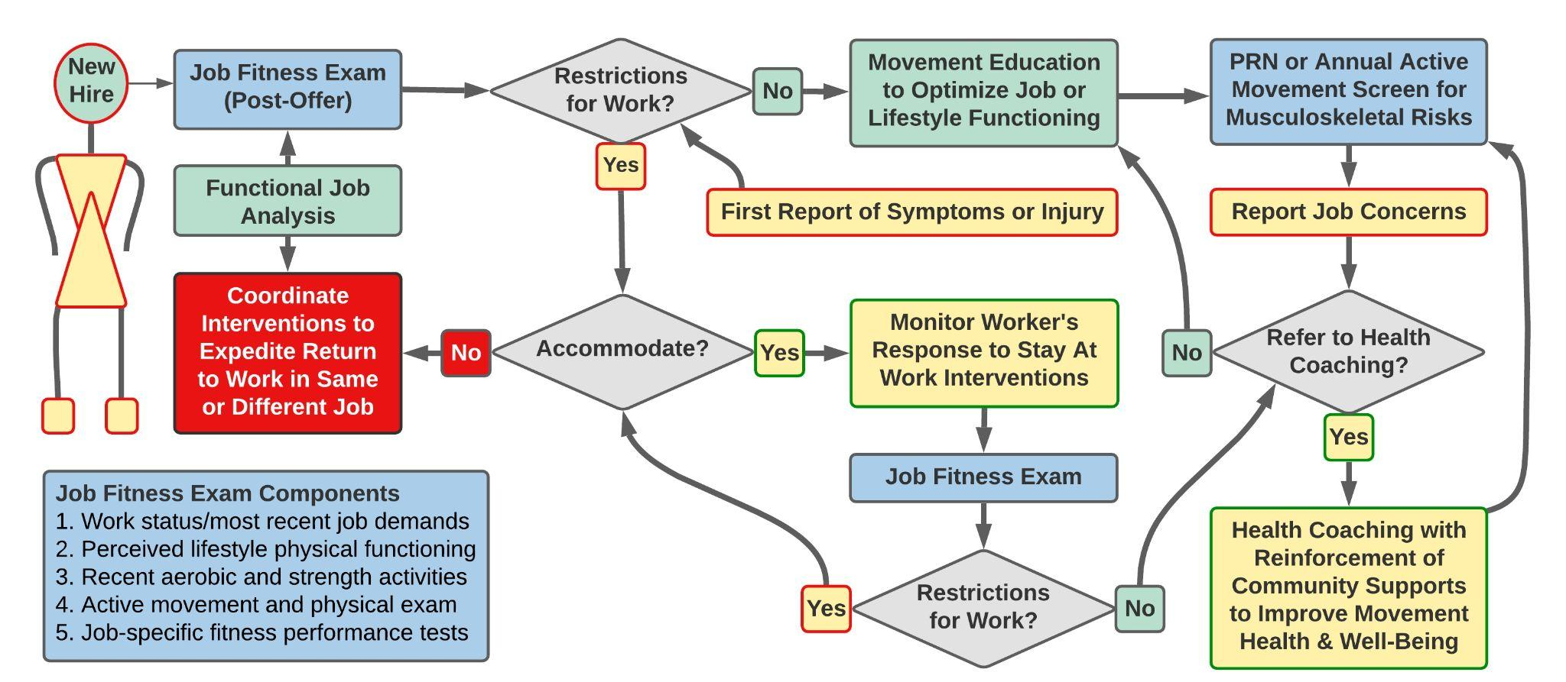
Movement Health & Well-Being from Hire to Retire
Flow Chart Source: Occupational Health Special Interest Group. Independent Study Course 32.4 Bridging the Gap Between the Workplace and Therapy Clinic. Academy of Orthopaedic Physical Therapy; 2022; pg 25.
Notes:
(work status examples: full duty, restricted duty, off duty)
In our LBP example with Randy, this graphic is supposed to illustrate different paths a worker may take. The best case scenario would be a POET that Randy passes, leading him straight from test to hire with a status of ‘full duty’. This may include an movement education or an annual screen to ensure no changes occur over time. An injury can often cause new deficits. This may result in an initial status of ‘off-duty’, requiring interventions and management for RTW. Either after an off-duty case or sometimes immediately after hire, accommodations and/or restrictions can be put in place depending on a worker’s needs. This would include modified work or restricted-duty in order to allow for them to continue their work onsite. Once they return to full duty, health coaching and annual screens become necessary in order to prevent risk factors in the future.
Overall, the purpose of this graph is the highlight that a path to return to work is not always linear, and there is often an optimal route for both employer and employee when they can work in limited capacities vs. completely off-duty. Navigating these can be difficult without the proper people and resources.

Slide 13
Communication Between Stakeholders
Difficulties for traditional clinic PT to find time for:
Communication between stakeholders
Understand the work environment
The functional job demands.
Benefits of entry point PT direct to employer!
Clarify job demands
Worker’s functional capabilities
Ergonomic opportunities
Educational opportunities
Identify temporary work modifications to allow for a graded RTW plan
Employer representatives can be limited as well:
Limited communication with offsite medical providers
Difficulty interpreting/implementing restrictions to accommodate.
Notes:
Beginning the “sell” of a PT as initial contact
A PT with an occupational health background is a great first contact to initiate the pathway decisions from the last flowchart to maximize outcomes. Previously, a company have used traditional outpatient PT clinics after a claim and visit to primary care. This care has often already been delayed, and the worker is typically put off-duty right away. When they get to outpatient at that point, there are additional difficulties traditional OP PTs have with navigating communication between the worksite and primary care, and the PT often only has the subjective descriptions from the patient of the work environment and job demands, which can lack specifics that are helpful in return to work planning. The employer representatives can have difficulties as well in finding time to communicate with offsite providers, or may have difficulties interpreting/implementing restrictions that were recommended.

Slide 14
Communication Between Stakeholders
Entry point care has the potential to help situations like Randy’s
At onset, PT referral is appropriate and can play a vital role in a worker’s recovery
Purpose of communication is worker status, goal setting, and progress toward discharge
Review job demands, transitional work, accommodations, and work restrictions
From the CPG: *reduced costs at 1 and 5 year follow ups with use of coordinated care* Louisel, Lemaire, Poitras, et al
Notes:
Image Link Intro PT role in facilitating communication *how should I cite sources in this kind of presentation?*
The CPG also recommends communication between the employee, employer, health care providers, and case managers. Entry point PT is excellent in facilitating this: they can keep employer and primary care up to date on the worker’s status and progress toward DC. Having an in-person look at job demands, transitional work, and accommodations can allow for much more targeted treatments and the potential for new modified tasks and ergonomic changes to occur, again allowing for reduced off-duty and total claim costs. The RTW CPG references a study regarding coordinated care, which did find reduced costs at 1 and 5 year follow ups.

Slide 15
Communication Between Stakeholders
The Employer’s Role:
Claims reported to promptly to claims admin
Job description shared with physician and physical therapist
Report of light or modified duty options
Ensure compliance with job restrictions
Notes:
Communication to Optimize PT Outcomes. Employer role in stakeholder communication
In order to maximize the communication between stakeholders, the employer has a role to promptly report claims, share the relevant job description, and report modified duty options. When the employee does return, the employer should assist with ensuring compliance with the job restrictions that were put in place.

Slide 16
Communication Between Stakeholders
The Treating Physician’s Role:
Referral to PT should include:
Clear health history
Reason for referral
Goals for recovery
Ensure authorizations are in place (depending on jurisdiction)
Automated referral can expedite process
Notes:
Communication to Optimize PT Outcomes. Treating physician role in stakeholder communication
The treating physician, in communicating between these stakeholders, should ensure the PT referral includes a clear medical history, reason for the referral, and goals for recovery. By ensuring authorizations are in place, the entire process will be more efficient. Even more so with automated referral.

Slide 17
Communication Between Stakeholders
The Claims Administrator’s Role:
Expediently approve treatment requests and monitor appointment statuses
Convey approvals for treatment and timelines
Address denial of care and provide explanations for involved parties
Address billing disputes
Report on final results at end of a claim
Notes:
Communication to Optimize PT Outcomes. Claims admin role in stakeholder communication
The Claims Administrator’s role is to quickly approve treatment requests and monitor appt statuses to ensure care is being provided. Promptly convey approvals for treatment and the necessary timelines. Address denial of care and provide explanations to the involved parties. In the case of a denial of compensability, explain to all parties to prevent provision of inappropriate treatment. Address billing disputes as they arise, and report on final results at the end of a claim.

Slide 18
Communication Between Stakeholders
The Physical Therapist’s Role:
Prevent appointment conflicts between doctor and therapy
Updates per session to claims adjuster and treating physician
Notable progress
Obstacles (physical, psycho-social)
Attendance vs. missed appointments
Provide final report including objective data and ability to perform job-specific tasks
Notes:
Communication to Optimize PT Outcomes. PT role in stakeholder communication
The PT role is to prevent appointment conflicts with primary care, and update per session to the adjuster and physician, especially in regard to notable progress that may change restrictions, obstacles, and any attendance issues. At the end of therapy, provide a final report with objective data demonstrating ability to perform job-specific tasks.
While these are the stakeholders we focused on today, it is important to note that the team includes others, such as: The worker, case manager, and/or various employer representatives (such as supervisor or safety professional). Some other situational players can also include ergonomists, pharmacy, dieticians, psychology, and social work.

Slide 19
Communication Between Stakeholders
Communication between stakeholders can improve outcomes and reinforce positive recovery expectations
—
Allows for earlier RTW by way of transitional duties, or to ensure safe RTW without restriction
—
Increasingly important when risk factors exist for delayed RTW
Notes:
With this multidisciplinary approach, there are overall improvements in injury management and will help to set expectations amongst all parties. This allows for earlier return to work through either transitional duties or a safe return to work with full duty. Communication as discussed so far becomes increasingly important in the presence of risk factors that increase likelihood of a delayed return to work.

Slide 20
Delayed RTW
Type of injury
Perceived Disability
History of previous episodes
Severity of pain; pain behaviors
Risk Factors
Psychosocial factors
Low self efficacy
Comorbidities
Fear avoidance
Extended absence prior to referral
Low recovery expectations
Notes:
RF discussion
Risk factors for delayed return to work causes communication between stakeholders to become increasingly important. These factors can change the education provided to the patient, projected return to work dates, and whether modified work is necessary. Again, entry point care is well positioned to identify these factors and address them or refer out as necessary. Psychological factors are ones that are modifiable, such as perceived disability, low recovery expectations, or fear avoidance. With prompt evaluation and proper treatment started, the worker can have a better understanding of their condition and the likely course of their care. When this process is not started efficiently, psychological factors are more likely to occur, leading to increased length of care, delayed RTW, and an increase in associated costs.

Slide 21
Delayed RTW
If disability duration decreases, costs decrease.
Minimized with:
Early contact between workplace, provider, and worker
Work accommodations
Ergonomic worksite visits
Direct cost reductions averaging $1195 per case, conservatively, not including indirect costs ^{Arnetz et al}
Notes:
References in CPG #100. Franche et al. CPG # 15 Arnetz et al.
When there is a delayed return to work, as mentioned, there are associated costs. Conversely, when disability duration decreases, costs will likely decrease. To summarize some of the points thus far, one can minimize disability duration through early coordinated care, the availability of work accommodations, and with preventative measures such as ergonomic worksite visits. PTs are once again well positioned to deliver these services. To provide a more objective view on what potential savings would look like, the RTW CPG references another study in which direct cost reductions averaged $1195 per case. This is considered conservative, as it did not account for indirect costs, such as lost work time, absenteeism, presenteeism, and morale.

Slide 22
Barriers to Entry Point Care
Despite research advocating these benefits, there are barriers
PCPs may not know which patients benefit from early PT
Some patients do not want or seek out PT for a variety of reasons
Employers do not always know the options available to them
PTs have extensive knowledge/training on managing MSD
Increase awareness that PTs are allied health care providers
Setting up preferred provider relations creates a more efficient process
Team approach helps foster RTW and facilitates recovery
Alignment on goals and good communication reduces barriers and improve outcomes
Notes:
There has been a lot of positive progress for the roles PTs can have in occupational health due to the latest research coming out, including the CPG mentioned today. There are of course still barriers, however.
PCPs may not always know which patients benefit from early PT, and some patients do not want PT for a variety of reasons. Employers also do not always know all the options available to them when a worker gets injured. As the PT scope and access evolves, we are continuing to educate patients and providers on both the knowledge and training that goes into a PT training that qualifies us to manage MSD, as well as our role as an allied healthcare provider. Setting up a preferred provider is another way to reduce these barriers. Having consistent providers allows for trust to develop between the workers, workplace, and the medical staff. With this team approach in place, improved return to work is fostered and recovery is facilitated. As the stakeholders align on goals and communicate, we can reduce barriers to care, improve outcomes, keep workers safe and healthy, and save money in the process.

Slide 23
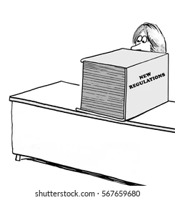
Legal and Regulatory Precautions
Injury prevention vs. first aid vs. treatment
ADA: qualified disability and reasonable accommodation
HIPAA: employee data collection and storage
Non-discrimination in hiring, wellness programs
Important for clinicians to have knowledge of workplace issues, such as occupational health PTs
Notes:
Image Link Legal precautions and the OHP practitioner knowledge
In the realm of workers comp, there are a many laws and regulations to be aware of. When onsite for example, first aid and treatment are different, and if an injured worker comes in and receives “treatment”, that becomes a recordable case, while someone who receives “first aid” would not become a recordable case. There are also rules related to ADA, HIPAA, and non-discrimination that must be carefully considered when developing programs, hiring, and providing accommodations. It becomes necessary then, to have clinicians familiar with these rules and able to navigate them. PTs that specialize in occupational health are well versed in these rules, even more so if they have an Occupational Health Practitioner certification.

Slide 24
Occupational Health Practitioner (OHP) Certificate Program
OHP
Webinar 32.W3​ (12 CEUs)​
Mentoring/Peer Review
ISC 32.5 (15 CEUs) Advanced Programs​
ISC 32.4​ (15 CEUs) Entry-Point​ Essentials
https://www.orthopt.org/content/special-interest-groups/occupational-health/occupational-health-practitioner-certificate-program
Your path to excellence in Occupational Health!
Notes:
OHP Program plug
The Occupational Health Practitioner certification was created by the OHSIG to standardize the information that occupational health practitioners have at their disposal,pulling from the CPG discussed at the beginning, that encompasses everything discussed in this talk thus far. The OHP certificate allows the practitioner to be knowledgeable in onsite care, ergonomics, health and wellness programs, employment testing, and more, including the laws and regulations around these areas. And the best part - we are creating a free-to-use directory to find people with this certification, so that you as an employer know you are getting someone qualified for helping your worksite and workers.

Slide 25
Occupational Health Practitioner Certificate - Academy of Orthopaedic Physical Therapy (AOPT)
Notes:
redirect to search tool when completed

Slide 26
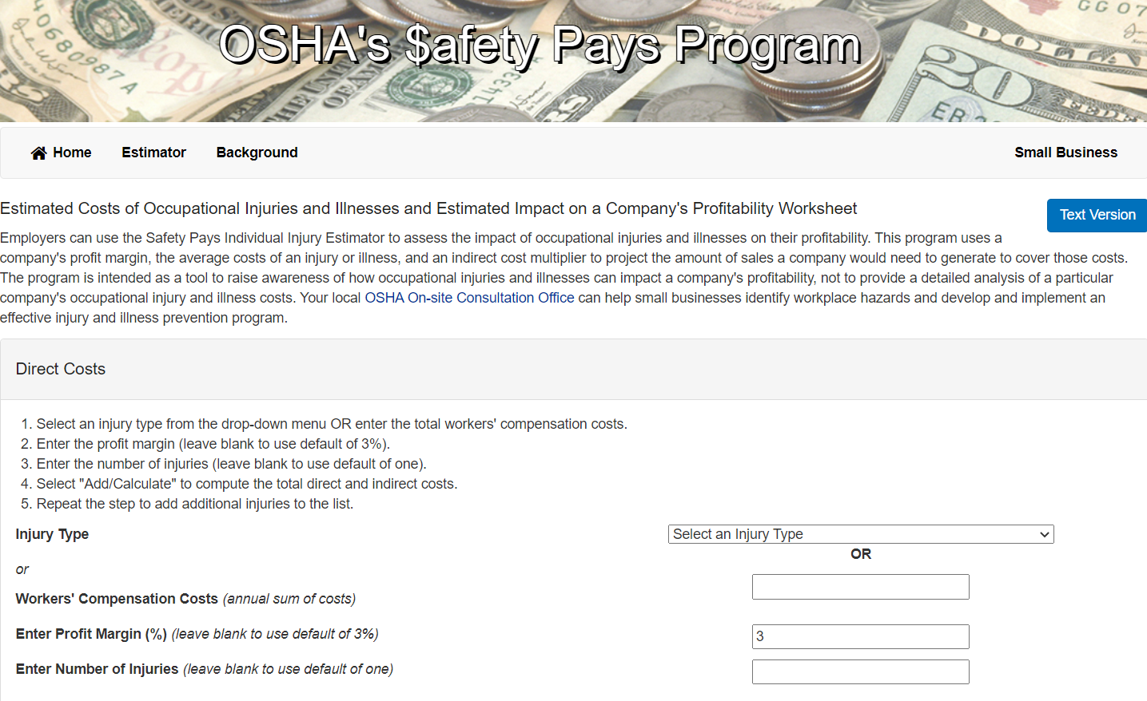
Savings Calculator
https://www.osha.gov/safetypays/estimator
Notes:
OSHA Calculator Example
OSHA provides a useful calculator to estimate how much various injuries cost to a company, given Workers Comp costs, the profit margin of the company, and the number of injuries that occur.

Slide 27
Savings Calculator
https://www.osha.gov/safetypays/estimator
Notes:
OSHA Calculator Example
In this example, we can take Randy’s case, and see what will happen with an low back strain with just 1 incident, given a 3% profit margin.

Slide 28
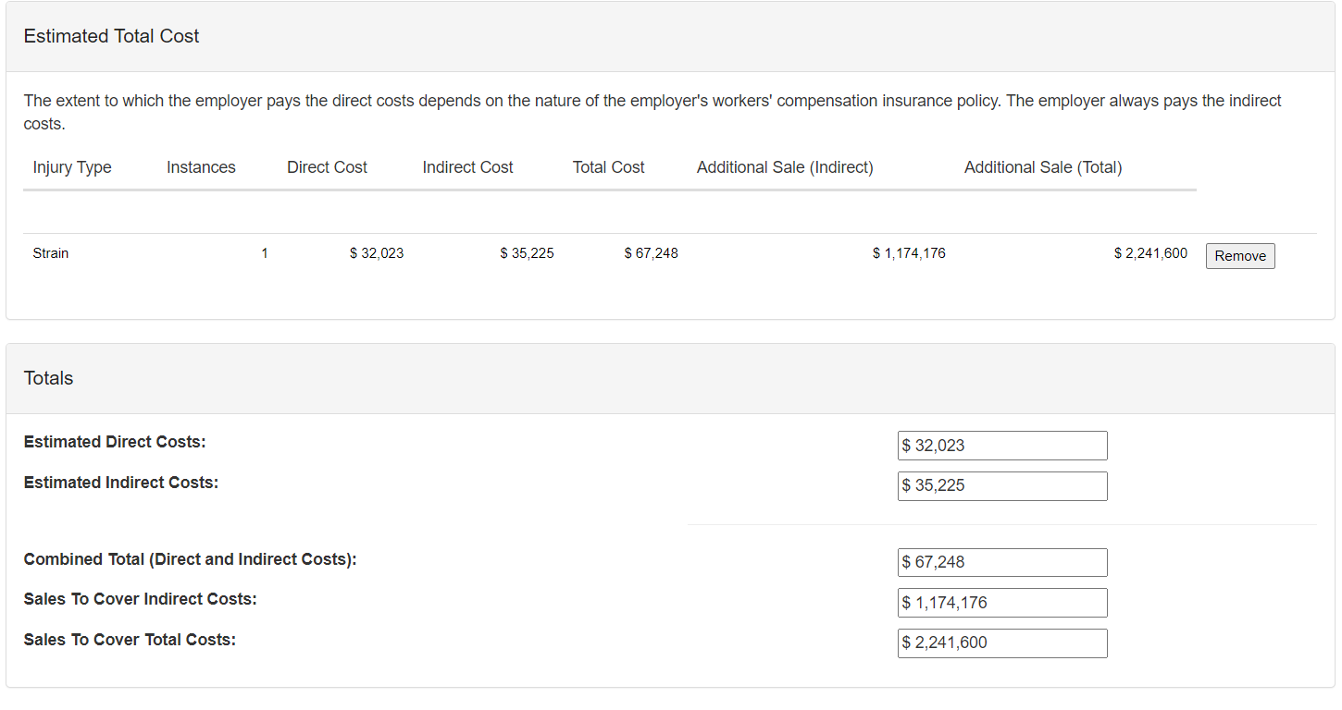
Notes:
OSHA Calculator Example
With randy’s injury of a low back strain, you can see direct costs, which include the cost of the claim and legal fees, as well as indirect costs, such as lost productivity, absenteeism, presenteeism, lost work time, and loss of morale. You can see here, with a 3% profit margin, to account for the 67k losses, the company would need to produce a total of 2.2mil in sales to break even. This is a huge opportunity for employers to create a better work environment, improve morale, and save money at the same time by focusing on injury prevention, or when injuries do occur, by providing modified work tasks that allow employees to stay at work, and finally to seek efficient and effective treatment that takes into consideration the job role and the company.
Discuss details of different injury examples?

Slide 29
Scenario Discussion
What are ways we can provide the best possible trajectory for Randy either before or after an injury?
Notes:
Scenario Discussion (interactive)
Discuss with a neighbor what steps need to be in place in order to allow for the best trajectory for RTW for Randy …. (After discussion, have people share). Some ideas: ergonomic screens and injury prevention classes. Job assessments to minimize risks. Preferred provider contacts. Onsite screening service. Onsite PT staff. Designated modified work tasks
Best case is always prevention. This has the lowest expenses (or none) and low injury rates keep insurance premiums low. It is also not realistic to expect 100% injury prevention however. Minimizing an injured worker’s time away from work and allowing modified work has been associated with quicker RTW and less recurrence of MSD related sick leave. Even with everything in place, there are occasionally injuries that lead to long term inability to perform essential job functions. Even then, PT can help play a role in setting restrictions or accommodations, and allow the worker a chance to continue contributing, even if with different job tasks or roles.

Slide 30
Summary
PTs can provide entry point care with notable benefits for the employer and the employee
The Work Rehabilitation CPG highlights current best practice for occupational health practitioners
Communication between stakeholders is critical to achieve the maximum value for the services provided
Legal precautions should be considered but are not barriers to entry point care for physical therapists
The OHP program provides for employers a list of qualified individuals to perform occupational health services
Notes:
To summarize, PTs are qualified to provide entry point care that have notable benefits for both employer and employee. The new work rehab CPG allows for occupational health practitioners to utilize research based best practice, and highlights PT as a good resource as the first point of contact. When good communication occurs between stakeholders, both quality of services and outcomes improve. The new OHP program allows for skilled practitioners to be easily accessible by database for prospective companies/employers looking into these services. The OSHA calculator can be used to estimate likely savings for injuries that are most common in different sectors.

Slide 31
References
Arnetz BB, Sjögren B, Rydéhn B, Meisel R. Early workplace intervention for employees with musculoskeletal-related absenteeism: a prospective controlled intervention study. J Occup Environ Med. 2003;45:499-506. https://doi.org/10.1097/01.jom.0000063628.37065.45
Childs JD, Fritz JM, Wu SS, et al. Implications of early and guideline adherent physical therapy for low back pain on utilization and costs. BMC Health Serv Res. 2015; 15:150. doi.10.1186/s12913-015-0830-3
Concentra, QBE Financial, R&I Brand Studio. For successful management of workers' comp claims, communication between stakeholders is key. Risk & Insurance. https://riskandinsurance.com/sponsored-for-successful-management-of-workers-comp-claims-communication-between-stakeholders-is-key/. Published April 4, 2022. Accessed February 20, 2023.
Daley, D, Payne, LP, Galper, J, et al. Clinical Guidance to Optimize Work Participation After Injury or Illness: The Role of Physical Therapists. J Orthop Sports Phys Ther. 2021;51(8):CPG1-CPG102. doi:10.2519/jospt.2021.0303.
Loisel P, Lemaire J, Poitras S, et al. Cost-benefit and cost-effectiveness analysis of a disability prevention model for back pain management: a six year follow up study. Occup Environ Med. 2002;59:807-815. https://doi. org/10.1136/oem.59.12.807
Notes:
Here are the references used in creating this presentation.

Slide 32
References
McGill TE, Stern DF, Kolber MJ, McGee J. Cost outcomes of physical therapist providers compared to primary care providers in the treatment of musculoskeletal patients in a military treatment facility: a retrospective chart review. Internet J Allied Health Sci Pract. 2021;19(2):Article 4. doi:10.46743/1540- 580X/2021.2000
Mintken PE, Pascoe SC, Barsch AK, Cleland JA. Direct access to physical therapy services is safe in a university student health center setting. J Allied Health. 2015;44(3):164-168.
Moore JH, McMillian DJ, Rosenthal, MD, Weishaar MD. Risk determination for patients with direct access to physical therapy in military health care facilities. J Orthop Sports Phys Ther. 2005;35(10):674-678. doi:10.2519/jospt.2005.2141
Szymanek E, Jones M, Shutt-Hoblet C, Halle R. Implementation of direct access physical therapy within the military medical system. Mil Med. 2021 July 10;usab245. doi:10.1093/milmed/usab245
Workforce Safety. Quick Reference for Physical Therapist at Primary Treating Provider. Accessed October 30, 2021. https:// www.workforcesafety.com/sites/www/files/documents/medical_ providers/resources/Quick%20Reference%20for%20PT%20 as%20Primary.pdf
Zachry W, Flores R, Turkanis D. Great Communication is Key to Optimizing Physical Therapy Outcomes. Workers compensation news: Workcompcentral. https://ww3.workcompcentral.com/news/print/id/ac39e44d4cbeb8cd658a8f89e6423eaada572c7d. Published February 11, 2021. Accessed February 18, 2023.

Slide 33
Appendix A Legal and regulatory resources
The design and implementation of Health and Wellness programs (ACA) https://www.federalregister.gov/documents/2013/06/03/2013-12916/incentives-for-nondiscriminatory-wellness-programs-in-group-health-plans
Data collection in Employer-sponsored health incentive programs https://www.federalregister.gov/documents/2016/05/17/2016-11558/regulations-under-the-americans-with-disabilities-act
Individuals with qualified disabilities and reasonable accommodations https://www.eeoc.gov/statutes/titles-i-and-v-americans-disabilities-act-1990-ada
Safe storage of employee health data https://www.hhs.gov/hipaa/for-professionals/privacy/index.html
Consistent medical examinations and fair employment testing https://www.eeoc.gov/laws/guidance/enforcement-guidance-disability-related-inquiries-and-medical-examinations-employees
Notes:
Appendix A and B have some sample legal and regulatory resources that may be useful both for practitioners and for businesses.

Slide 34
Appendix B
Legal and regulatory resources: Onsite Care
Injury Prevention and first aid https://www.osha.gov/recordkeeping/
Incident investigation and work injury claims https://www.osha.gov/incident-investigation
Worker’s compensation direct access varies state to state https://www.apta.org/contentassets/dfbab801de554636b36485fcee62f83a/workerscompensationmapphysicianreferral.pdf

