Slide 1
DPT Imaging Education:
Will Graduates Be Prepared for Today & Tomorrow’s Practice?
Bill Boissonnault, PT, DPT, DSc, FAAOMPT, FAPTA Charles R. Hazle, PT, PhD

Slide 2
Objectives
Provide an update on current status of imaging curricula and DPT education
Provide an overview of challenges and opportunities related to integration of imaging curricula into DPT education

Slide 3
Agenda
The Why
The What / How
The Results
The So Whats
Q and A (Chat Box)

Slide 4
Assumptions
Advocating for appropriate utilization/ordering of imaging modalities
Advocating for appropriate training of DPT graduates; preparing for today AND tomorrow’s practice
Majority of patients with common MSK conditions do not need imaging

Slide 5
Assumptions
Do not want to become a part of the over-utilization problem
Do not want to become part of the inappropriate ordering problem: can lead to poorer outcomes including functional outcomes, mental health, work/social limitations, unnecessary invasive tests/procedures, increased costs.

Slide 6
Diagnostic and Procedural Imaging Curricula in Physical Therapist Professional Degree Programs
2014
Diagnostic and Procedural Imaging Curricula in Physical Therapist Professional Degree Programs: Update
2023
Why Now?

Slide 7
APTA Position on Diagnosis(
APTA Position on Diagnosis
(HOD P06‐12‐10‐09), Diagnosis by Physical Therapists states: “…….When indicated, Physical Therapists order appropriate tests including but not limited to imaging and other studies, that are performed and interpreted by other health professionals. Physical therapists may also perform or interpret selected imaging or other studies……”
HOD adopted RC 12-16-resolved that APTA pursue practice authority for imaging referral in physical therapist practice. 12-16-resolved that APTA pursue practice authority for imaging referral in physical therapist practice.
HOD P06‐12‐10‐09), Diagnosis by Physical Therapists states: “…….When indicated, Phys

Slide 8
CAPTE Evaluative Criteria: Standard 7
The physical therapist professional curriculum includes content and learning experiences in the biological, physical, behavioral and movement sciences necessary for entry level practice. Topics covered include anatomy, physiology, genetics, exercise science, biomechanics, kinesiology, neuroscience, pathology, pharmacology, diagnostic imaging, histology, nutrition, and psychosocial aspects of health and disability.
**Diagnostic Imaging added 11/11/15

Slide 9
CAPTE Evaluative Criteria: Standard 7
The curriculum includes content, learning experiences, and student testing and evaluation processes designed to prepare students to achieve educational outcomes required for initial practice in physical therapy and for lifelong learning necessary for functioning within an ever-changing health care environment.

Slide 10
ThThe Model Practice Act for Physical Therapy: A Tool for Public Protection and Legislative Change (MPA) is the preeminent standard and most effective tool available for revising and modernizing physical therapy practice acts.
Model Practice Act 7th Edition| FSBPT

Slide 11
FSBPT Model Practice Act 7th edition
1717. “Practice of physical therapy” means:
d. Referring a patient/client to healthcare providers and facilities for services and testing to inform the physical therapist plan of care.
22. “Testing” means standard methods and techniques used to gather data about the patient/client, including but not limited to imaging, electrodiagnostic and electrophysiologic tests and measures. “Practice of physical therapy” means:
d. Referring a patient/client to healthcare prov

Slide 12
Practitioner Qualifications
W
Wisconsin language adopted in 2017 states qualified persons who can order plain film radiographs constitutes physical therapists that satisfy one of the following qualifications: 1) the PT holds a clinical doctorate degree in physical therapy (DPT)
North Dakota revised its practice act in 2021, allowing physical therapists holding a clinical doctorate of physical therapy to order plain film radiographs.
West Virginia Board of Physical Therapy, in 2022 provided a list of recommended qualifications for practitioners referring patients for imaging, a list that includes graduates of a CAPTE-accredited DPT program

Slide 13
Year of Approval | State | Plain Films Only | Plain Films Plus Other Imaging
2010 | DC |  | X
2012 | Colorado |  | X
2012 | Maryland |  | X

Slide 14
Date of Approval | State | Plain Films Only | Plain Films Plus Other Imaging
2017 | Wisconsin | XXX
2018 | Utah |  | XXX
2019 | New Jersey |  | XXX
2021 | North Dakota | XXX
2021 | Rhode Island | XXX
2021 | Arizona | XXX
2022 | West Virginia |  | XXX
2023 | Iowa |  | XXX Plus MRI

Slide 15
AOPT Education Manual
Imaging Education Manual for Doctor of Physical Therapy Professional Degree Programs. AOPT, APTA, Inc. 2015
History: Imaging and Physical Therapist Practice
Association Positions and Practice Standards
Legislative and Regulatory Status
Entry-Level Education
Foundational Basis for Imaging in Physical Therapist Education
Academy of Orthopaedic Physical Therapy Imaging SIG –
Imaging SIG - Academy of Orthopaedic Physical Therapy (AOPT) (orthopt.org)

Slide 16
APTA: White Paper
Diagnostic and Procedural Imaging in Physical Therapist Practice. Academy of Orthopaedic Physical Therapy, APTA, 2016
Historical Overview (Military Model: since early 1970s physical therapists have ordered imaging)
Physical Therapist Education and Training
Practice, Regulatory and Payment
Benefit to Health Care Delivery
The Future
https://www.orthopt.org/uploads/content_files/files/DxProcImagPhysTherPractice_FINAL%281%29.pdf

Slide 17
Diagnostic and Procedural Imaging Curricula in Physical Therapist Professional Degree Programs
2014
Diagnostic and Procedural Imaging Curricula in Physical Therapist Professional Degree Programs: Update
2023
Why Now?

Slide 18
Survey Methodology & Responses
Constructed on REDCap based on prior instrument
Reviewed for content & functionality by 5 prominent imaging educators
IRB approved at Univ of Kentucky
Launched Dec 15, 2022
To all CAPTE listed programs—accredited & developing

Slide 19
Survey Methodology & Responses
Initial email contact to program chair per CAPTE info
Request to be completed by chair or faculty member coordinating instruction in imaging
3 total group email contacts
Individual requests to known individuals & those likely to teach imaging based on program web page data
Appeared to yield apx 75% of responses

Slide 20
Survey Methodology & Responses
Data collection closed on April 1, 2023
Focused on CAPTE listing of 272 accredited programs
164 responses / 60.3% rate
Group data only—individual institutions not identified

Slide 21
Survey Methodology & Data Analysis
Reported data only from the responding accredited programs
Developing programs not included
Basic descriptive statistics
Counts & percentages
Some respondents did not answer all questions
Percentages & proportions only for responses to individual questions

Slide 22
Results
Imaging Introduced – When:
Year 1 (n = 103; 66.9%); (n = 72) in the first semester
Year 2 (n = 44; 28.6%)
Year 3 (n = 7; 4.6%)
How Imaging Integrated in Curriculum?
Required imaging course (n = 77; 47%)
Imaging is a component of multiple courses (68;41.5%)
Imaging content found within a required clinical science course (n = 52; 31.7%)
Imaging content found within a separate elective course by (n = 4; 2.4%)

Slide 23
Distribution of Instructional Hours

Slide 24
Imaging Emphasis in Curriculum
2014 Imaging Emphasis By Mean (%):
MSK 76.3% Adult Neuro 9.2%
CV/Pulm 7.7% Peds Neuro 2.9%
2023 Imaging Emphasis By Mean (%)
MSK 82.4% Adult Neuro 8.9%
CV/Pulmonary 6.4% Peds Neuro 2.6%

Slide 25
Why Heavy MSK Emphasis in Curriculum?
1. 67.7% of faculty reported orthopedic or sports as primary clinical practice areas
2. 62.8% reported orthopedic or sports clinical specialty certification compared to 6.4% having other certification(s)
3. 18 faculty reporting completion of an orthopedic/sports clinical residency program (of a total of 19 faculty)
4. 21.2% of faculty were Fellows of the American Academy of Orthopaedic Manual Physical Therapists

Slide 26
Why Heavy MSK Emphasis in Curriculum?
5. The comparative long history of MSK imaging embedded in the military model of clinical practice,
6. Patient care settings described in many publications describing imaging and physical therapist practice being out-patient orthopedic settings
7. The 5 imaging modalities investigated, may be more relevant to MSK clinical practice compared to other practice settings.

Slide 27
2023 Content Area Contact Hours

Slide 28
Assessing Student Competency
2023 Survey
Written Exam (90.9%)
Practical Exam (37.2%)
Simulated Patient (20.7%)
Oral Exam (9.8%)
Real-Patient Exam (4.3%)
End of Curriculum Exam (36.4%)

Slide 29
Barriers to Including Imaging Content
Program Issues
Perspective Issues

Slide 30
Improving Student Knowledge & Competency

Slide 31
Resources Utilized for Students
McKinnis most frequently used

Slide 32
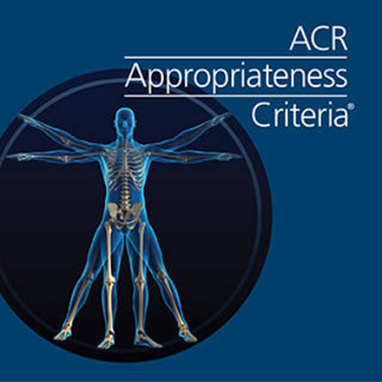
Resources Utilized for Faculty
McKinnis most frequently used

Slide 33
Resources Utilized for Faculty
Non-members using ACR-AC: 58%
Members using ACR-AC: 81%

Slide 34
Assessment for Student Competency
Ultrasound
Instructional Area | 2014 | 2023
Identify normal anatomy | 40.4 | 51.2
Identify skeletal pathological processes/injuries | 31.1 | 36.0
Identify soft tissue pathological processes/injuries | 40.4 | 57.9
Utilization of clinical guidelines for referral | 31.8 | 44.5
Adjunct to patient interventions | 45.0 | 45.7

Slide 35
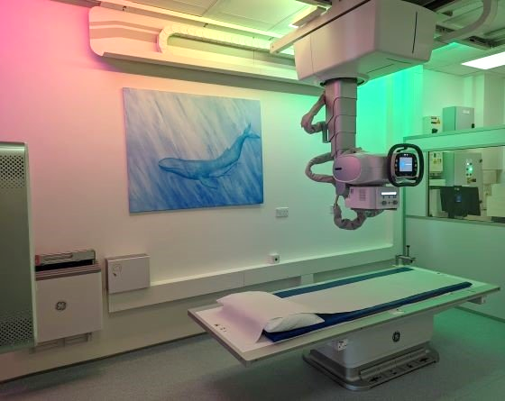
Expectations, Assessment & Competence
Example: Radiography
95.2% use of clinical guidelines for referral an entry-level skill
82.3% assess for competence
Perception of competence: 4.2 / 5
(3.7 in 2014)

Slide 36
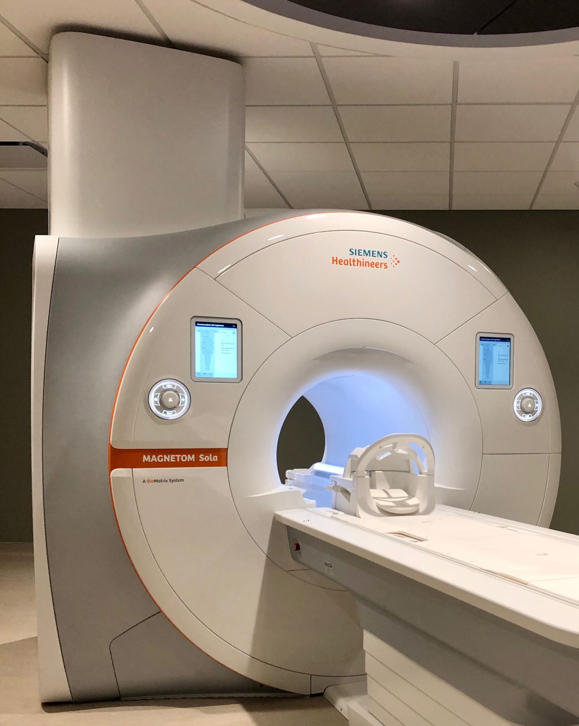
Expectations, Assessment & Competence
Example: MRI
84.4% use of clinical guidelines for referral an entry-level skill
62.8% assess for competence
Perception of competence: 3.7 / 5
(2.9 in 2014)

Slide 37
Faculty Perception of Student Competence
1 = Not competent
5 = Competent

Slide 38
Additional Comparisons 2014 to 2023
206 → 272 programs 32% increase
Many proportions similar
Perceived competency values with modalities have all increased
Greater recognition of use of ultrasound & value in PT practice
Some progress noted, but still have work to do

Slide 39
Challenges and Opportunities
“There’s no space in the curriculum to add new content!”
Instructors should make greater use of readily available resources
Tap into experts to assist
Integrate content throughout the curriculum
Teach content in clinical contexts
Distribution & dissemination of available resources
Strategies to enhance student knowledge/skills: “Greater emphasis during clinical affiliations/internships”
Partner with clinical instructors; provide education/training for CIs

Slide 40
Opportunities
Faculty to work cooperatively with local state associations re: education consistent with strategic planning for imaging privileges
Update the Education Imaging Manual: Inclusion of new survey data in revision
Better define competencies for DPT, residency and fellowship education experiences

Slide 41
Summary
Practice: The bar has been set for graduate responsibilities
APTA Position on Diagnosis (2012)
FSBPT Model Practice Act (7th edition)
Practice Act/Rules and Regs: Qualifications include DPT grad
Education: The bar has been set by
CAPTE: Standard 7 and
FSBPT: Diagnostic imaging is included in the Content Outline of the NPTE
Not a Matter of “If”, but “How best”

Slide 42
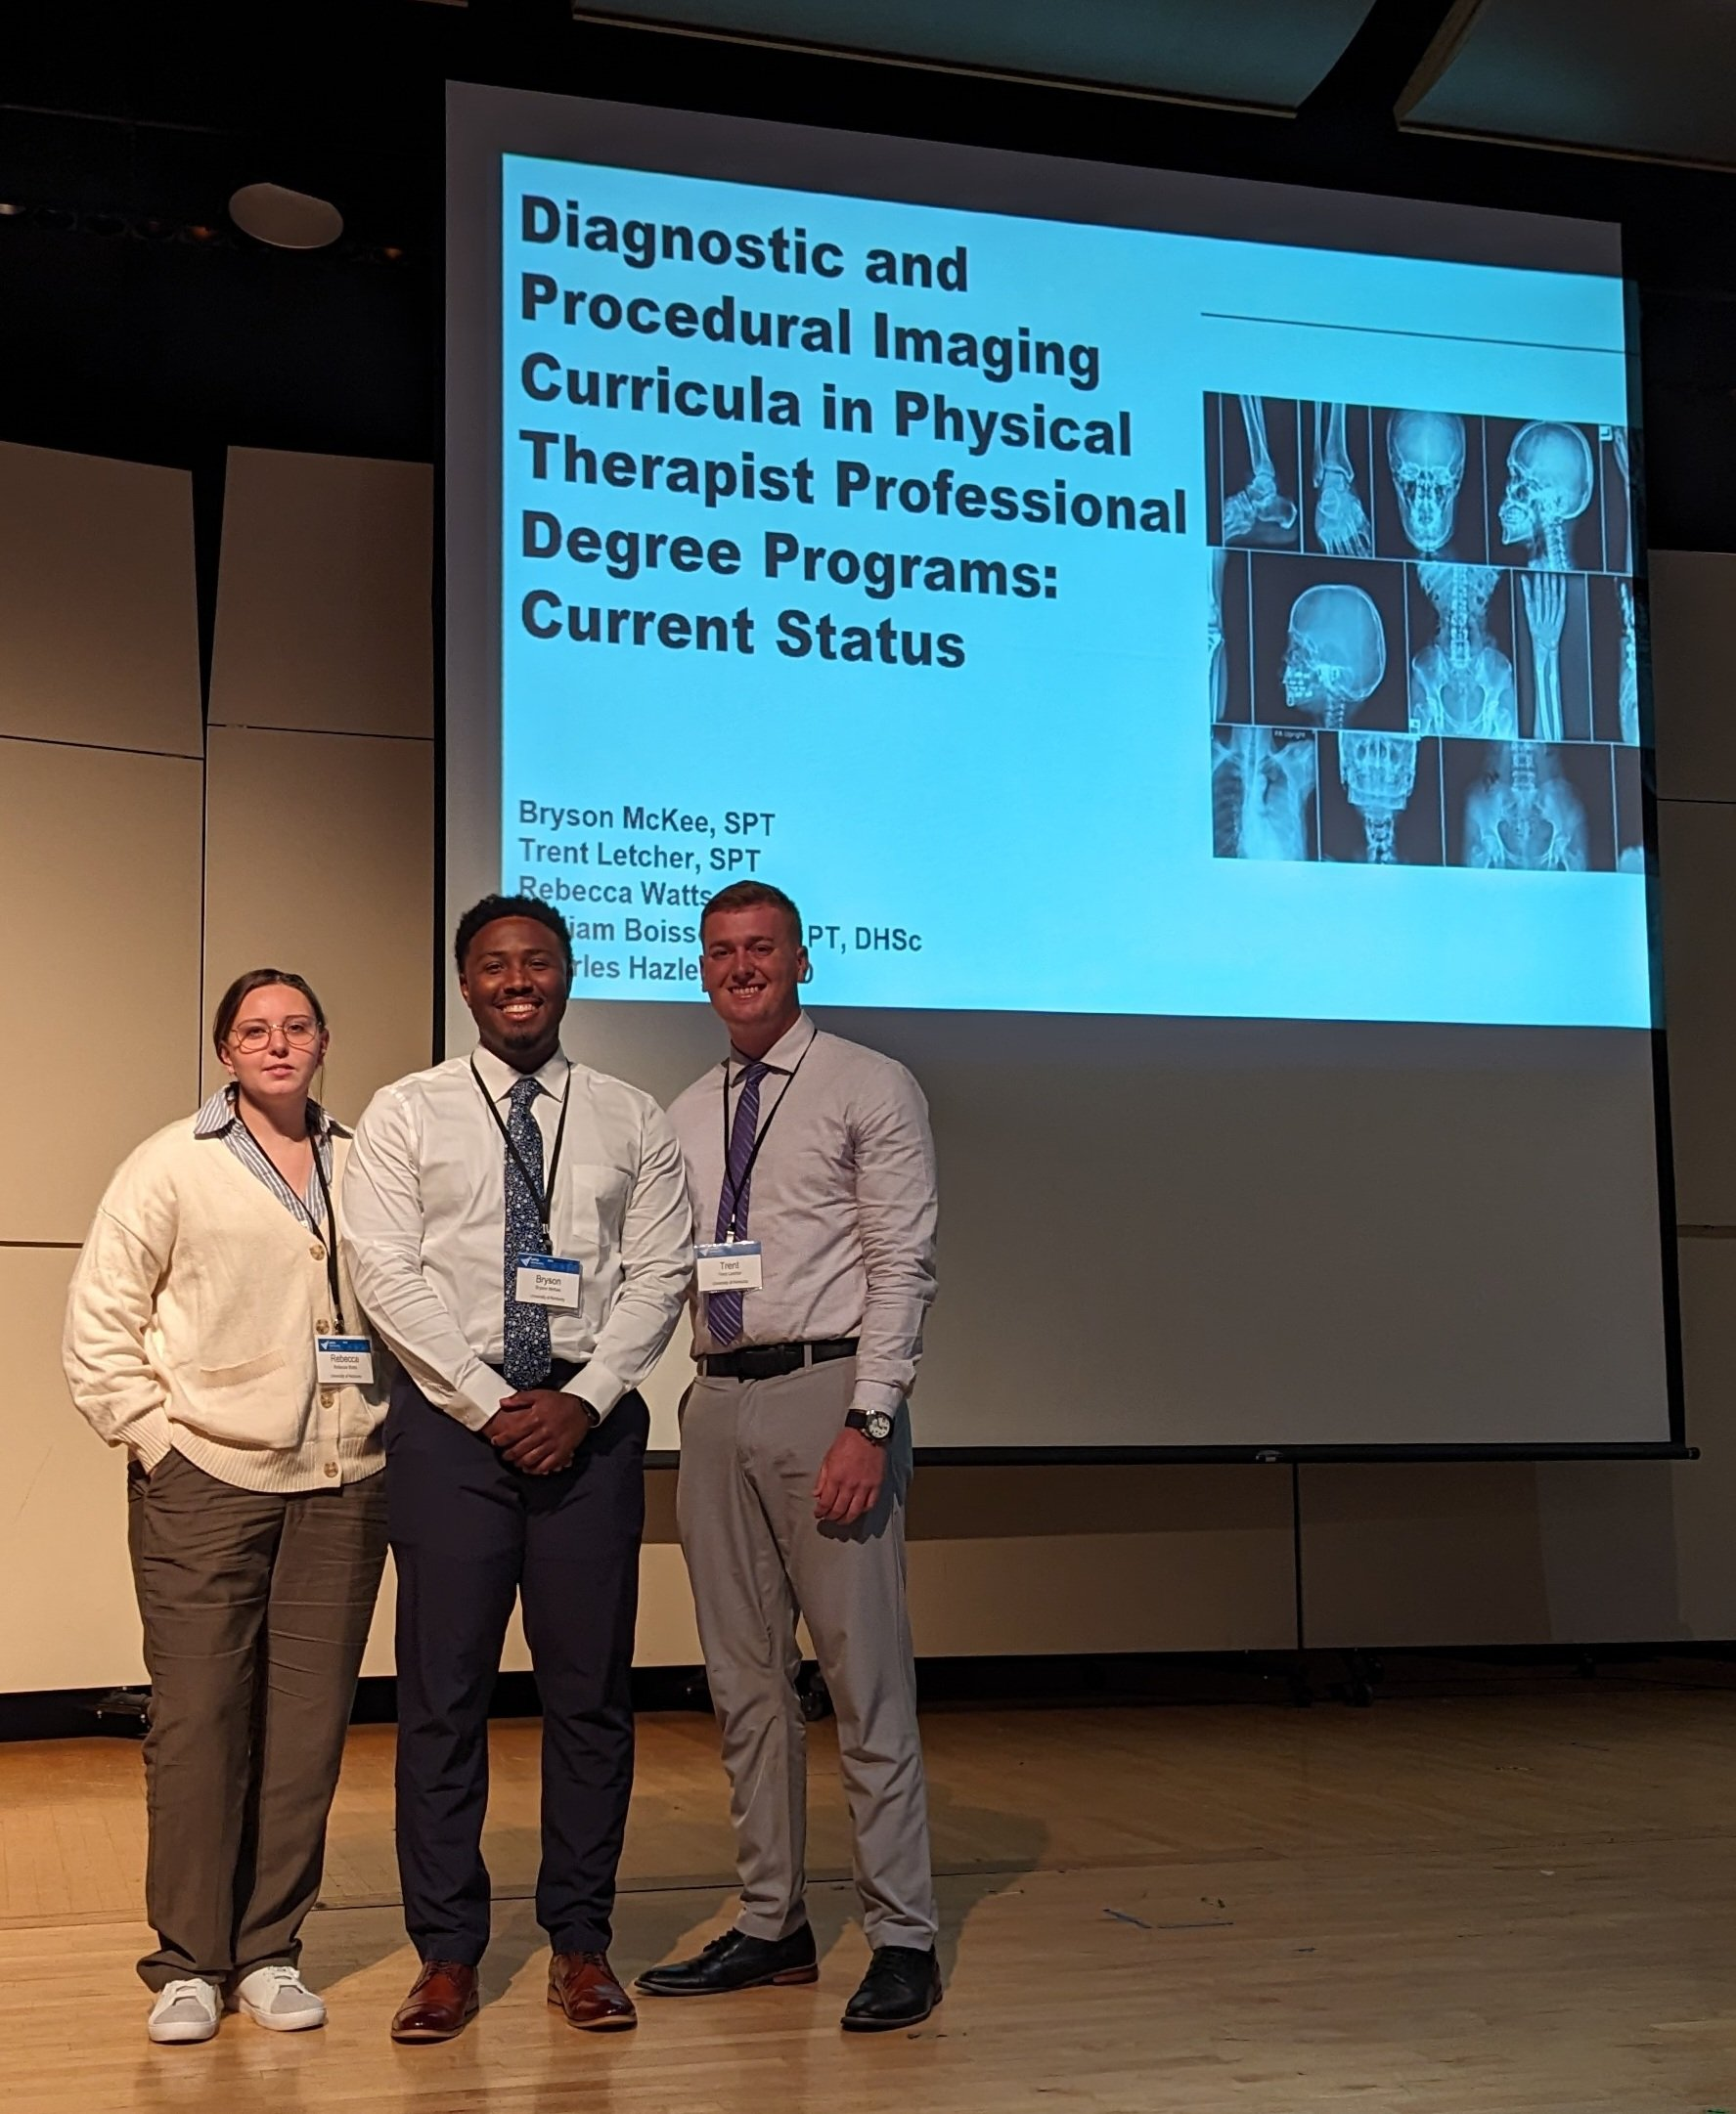
Acknowledgements
Univ of Kentucky 3rd Year DPT Students
Constructed Survey Instrument in REDCap & Assisted in Data Collection
L → R
Rebecca Watts, Bryson McKee, Trent Letcher

Slide 43
Acknowledgements
In Appreciation
Survey Participants
Survey Reviewers:
Aimee Klein, George Beneck, Mike Ross, Meg Sions, Brian Young
Imaging SIG

Slide 44
More Information
Bill Boissonnault:
wgboisso@wisc.edu
Charles Hazle:
crhazl00@uky.edu
(6th character lower case letter “L” followed by two numeral zeros)

Slide 45
References
Academy of Orthopaedic Physical Therapy. Imaging Educational Manual for Doctoral of Physical Therapy Professional Degree Programs. 2015. Available on Academy’s web-site. Diagnostic and Procedural Imaging in Physical Therapy Practice. 2016. Available on Academy’s web-site
Boissonnault WG, White, DM, Carney S, Malin B, Smith W. Diagnostic and procedural imaging curricula in physical therapist professional degree programs. J Orthop Sports Phys Ther. 2014;44(8):579-586.
Boissonnault W, Badke MB, Powers J. Pursuit and implementation of hospital-based outpatient direct access to physical therapy services: An administrative case report. Phys Ther. 2010;90:100-109
Burley T, Thein-Brody L, Boissonnault W, Ross M. Development of a musculoskeletal competency examination for physical therapists. Phys Ther. 2020;100(12):2254-2265.

Slide 46
References
Crowell MS, Dedekam EA, Johnson MR et al. Diagnostic imaging in a direct-access sports physical therapy clinic: a 2-year retrospective practice analysis. The International Journal of Sports Physical Therapy. 2016;11(5):708-717.
Crowell MS, Mason JS, McGinniss JH. Muscoloskeletal Imaging for Low Back Pain in Direct Access Physical Therapy Compared to Primary Care. An Observational Study. The International Journal of Sports Physical Therapy. 2022;17(2):237-246.
Keil A, Baranyi B, Metta S, et al. Ordering diagnostic imaging by physical therapists. A 5-year retrospective practice analysis. Phys Ther. 2019;99(8):1020-1026.
Keil A, et al. Hazle CR, Mauer A, et al. Referral for imaging in physical therapist practice: Key recommendations for successful implementation. Phys Ther. 2021;101(3):

Slide 48
2014 Imaging Integration into Curriculum
Content: Imaging theory, clinical application/skills
Average estimated total contact hour: 23.7 hours
Range 2 hours (4 programs) -75 hours (1 program)
60.8% Classroom/Lecture
17.3% On-line Coursework
15.3% Laboratory
Approximately 50% of contact hours-clinical guidelines for patient referral

Slide 49
2023 Imaging Integration into Curriculum
Content: Imaging theory, clinical application/skills
Average estimated total contact hours:
Mean 28 hours
Median 25.5 hours
Range 1 hour -296 hours

