Slide 1
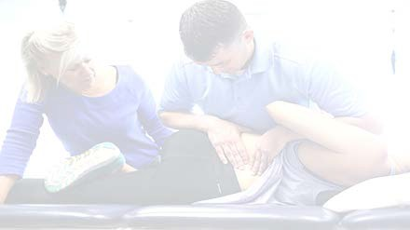
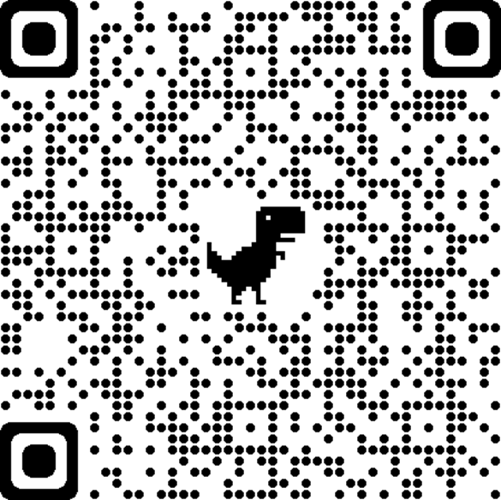
Academy of Orthopaedic Physical Therapy: ORF-SIG Member Meeting
Become a Member!
A community of excellence in Orthopaedic Residency and Fellowship Education

Slide 2

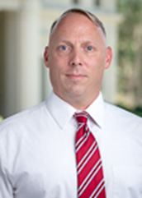
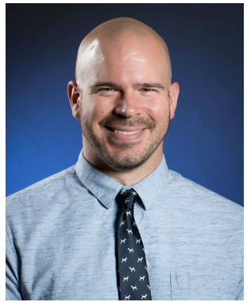
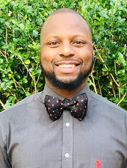
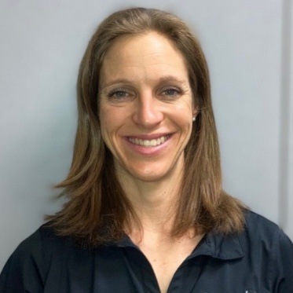

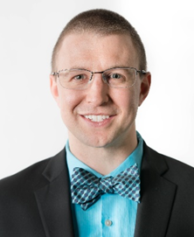
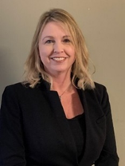
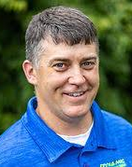
Leadership team: SIG Members and Terms: President: Molly Malloy Vice President: Kirk Bentzen Nominating Committee: Adam Walsh Christopher Thurston Leda McDaniel Representative to Board of Directors for ORFSIG – Nancy Bloom Research committee Chair – Steve Kareha Residency and SIG Educators – Kathleen Geist, Matt Haberl
Kirk Bentzen, Adam Walsh, Chris Thurston, Leda McDaniel,
Nancy Bloom, Steve Kareha, Kathleen Geist, Matt Haberl

Slide 3
Agenda
3:30-3:40 – Molly Malloy – Year Highlights and SIG to EC updates
3:40-3:50 – Kirk Bentzen – CSM updates planning
3:50-4:00 – Steve Kareha – Research updates and opportunities
4:00-4:10 - Adam Walsh – Education Updates
4:10-4:15 – Molly Malloy – Ways to get involved
4:15-4:30 – Open discussion

Slide 4
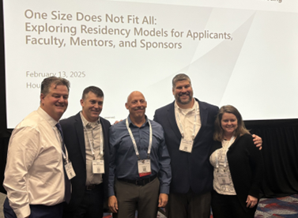
Highlights and Updates 2025
Continuing educational resources through CSM 2025
45 attendees for pre-con
Educational session
Platforms of resident case reports and research
APTA Orthopaedics Updated website
https://www.orthopt.org/content/special-interest-groups/residency-fellowship/developing-accredited-programs
Task Force AOPT Universal Residency Curriculum Workgroup
3 year project to have universal resources to support DRP
Task Force ISC Curriculum review completed
Research project – universal graduate survey, resident platforms
Post Professional Education Council – Leda McDaniel is our rep
Elected officials from variety of specialties looking at cost, support to programs, recruitment

Slide 5
SIG to Engagement Communities
Beginning at CSM 2026, all APTA Orthopedics Special Interest Groups (SIGs) will officially transition into APTA Orthopedics Communities.
This change allows us to align more closely with APTA Orthopedics structure, strengthen member engagement, and provide more flexible opportunities for leadership and participation.
Current SIG Presidents and Vice President/Education Chairs will automatically transition into the roles of Community Chair and Vice-Chair.
Each Community will have a Leadership Team made up of a Chair, Vice-Chair, and an APTA Orthopedics Board liaison.
Leadership terms are for two years, with a maximum of three consecutive terms in either Chair or Vice-Chair roles.
Communities may propose an annual budget, which will be reviewed by the APTA Orthopedics Board and Finance Committee for consideration.
Communities will have access to encumbered funds (funds raised or allocated specifically for their Community), however, all requests for utilization of encumbered funds must be submitted to the APTA Board of Directors for consideration. Encumbered funds utilization is not guaranteed.

Slide 6
SIG to Engagement Communities - 2
Communities can sponsor or co-sponsor educational events and fundraising activities.
Revenue from approved activities (e.g., pre-conference courses at CSM) is shared, with 50% of net profit returning to the Community’s encumbered funds.
Each Community will have a dedicated webpage and masthead managed in coordination with APTA Orthopedics staff.
Summary – not a lot will change for members
our focus is to support members with education, research, shared resources and working smarter not harder

Slide 7
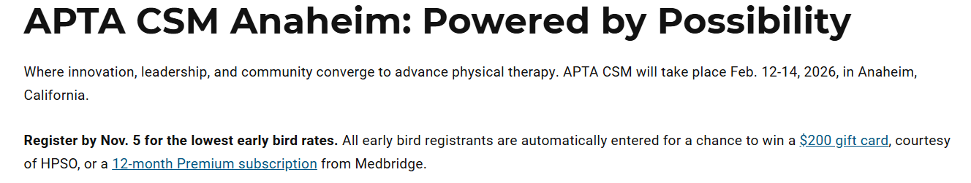
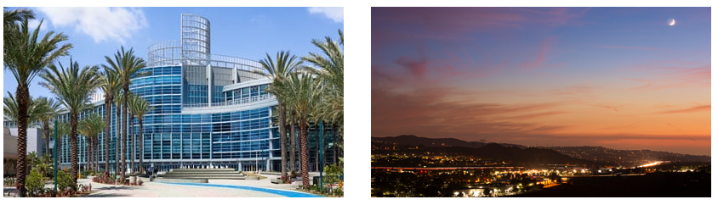

Slide 8

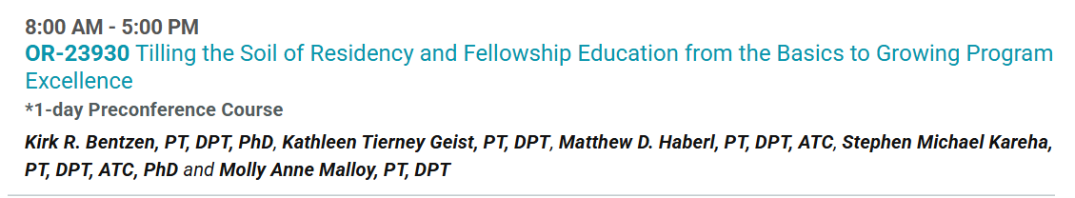
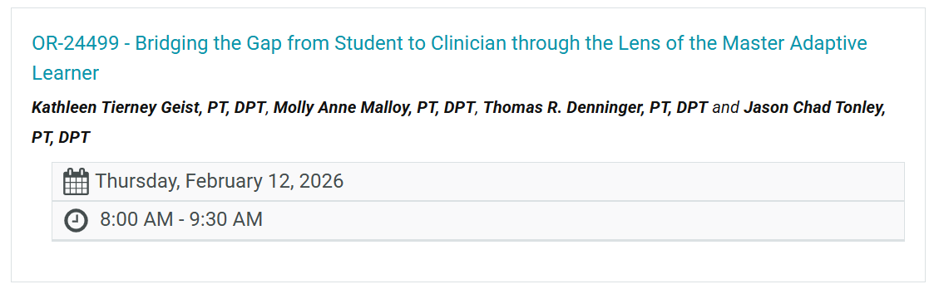
CSM 2026 – ORFSIG Key Content
Pre-Conference Wednesday 2/13/25

Slide 9
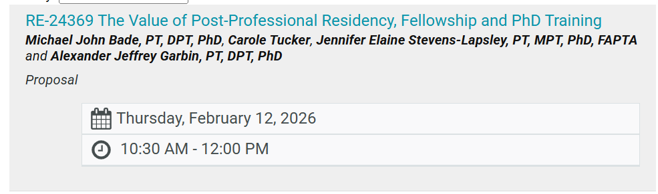
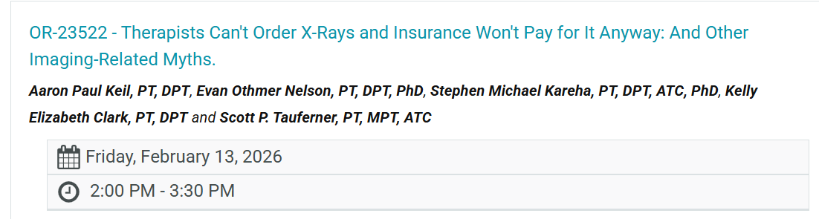
Kirk to Cover

Slide 10
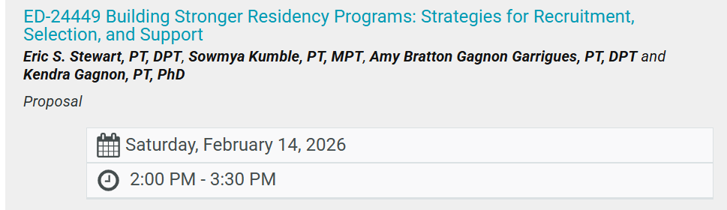
Kirk to Cover

Slide 11

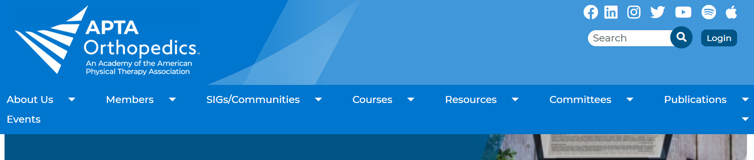
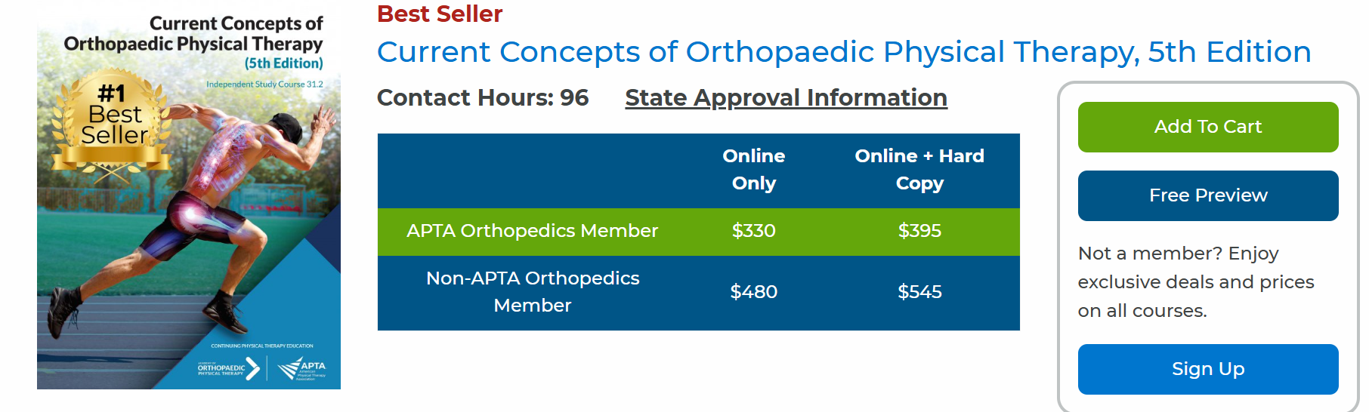
Education Resources
Current Concepts

Slide 12
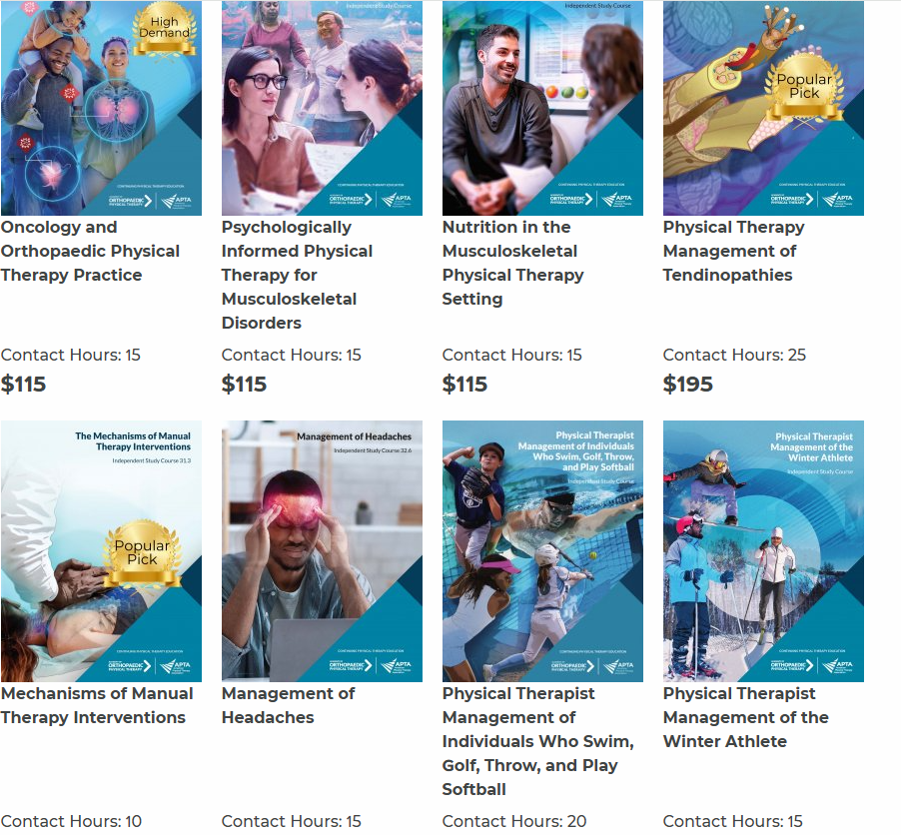
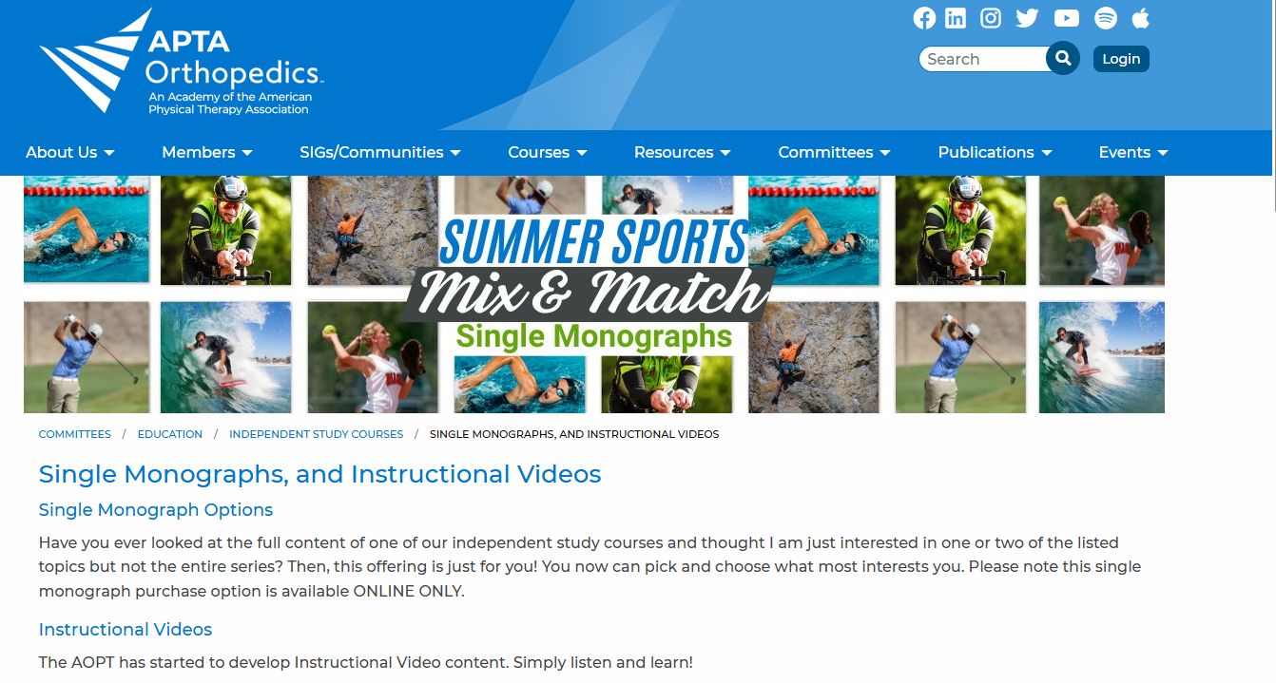
Adam to cover
Cost full CC = $330
Lower Quadrant = $220
Upper Quadrant = $245
Number of additional courses
Varying costs: Free, $55, $100, $245

Slide 13
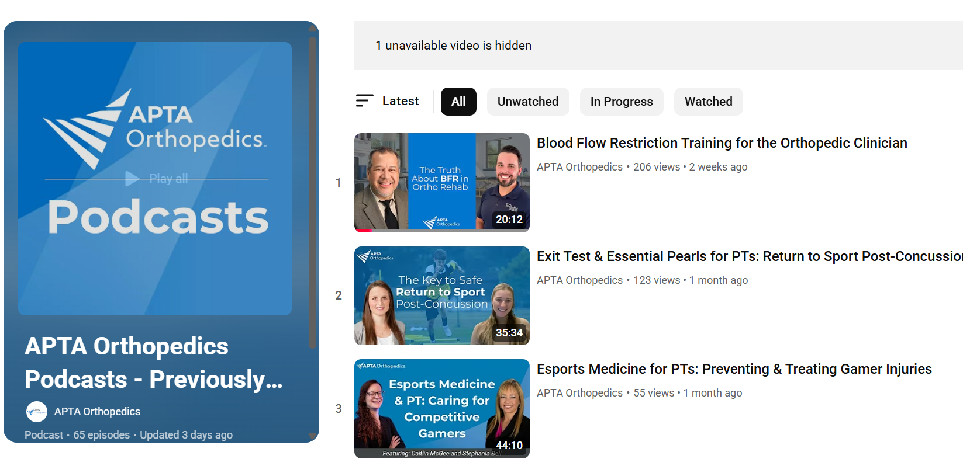
YouTube Education – Podcasts, CPG overviews - Adam

Slide 14
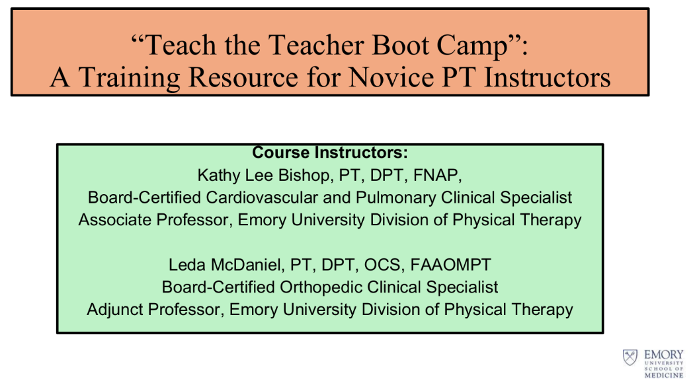
Adam to cover
Cost $250 PER PROGRAM
Contact:ledamcdaniel1@gmail.com
The goal of TTTBC is to provide resources including 1:1 mentoring for developing novice teachers.
Offered Virtually Self Paced Fall semester 12 weeks 45-60 min modules
Residents/fellows undergoing teacher training with the goal of preparing a Case Study class to be delivered

Slide 15

Education committee
Test questions available – would like to have a working doc to share with program directors will be a focus of the education committee to build a larger pool of OCS style exam questions
Email Molly Malloy malloyma@arcadia.edu for access to exam
Open Discussion - Other ideas or question what is needed to assist programs in success

Slide 16
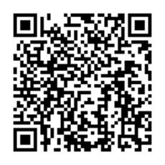
Research Committee Updates:
Steve to cover
Physical Therapy Residency and Fellowship Graduate Survey
Purpose: Identify the impact of residency and fellowship training on graduate’s careers
How to utilize and get feedback for your program

Slide 17
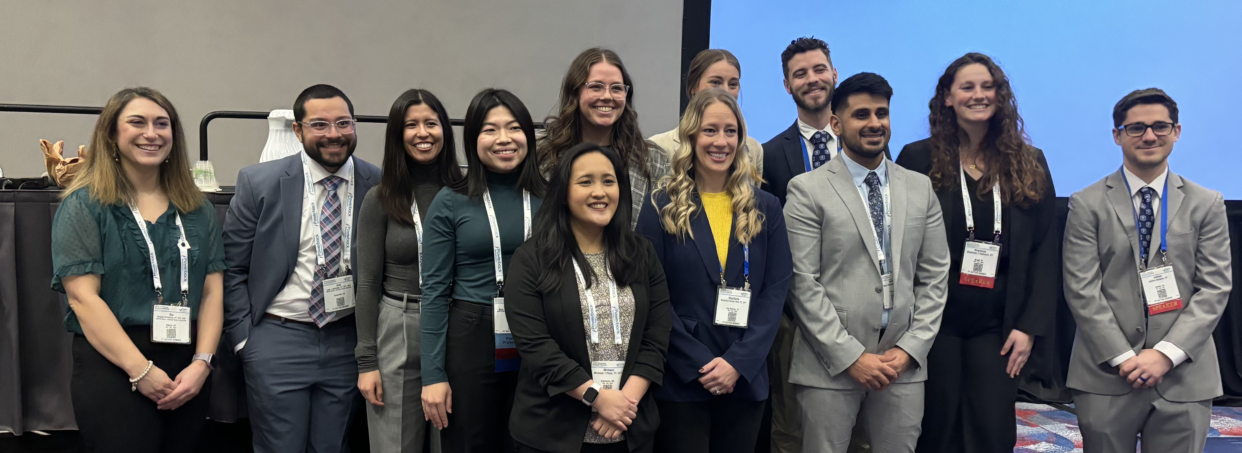
3rd Annual Ortho Resident Platforms
Steve to cover
Saturday 2/14 from 2 - 3:30
8 presenters were selected out of the 48 submissions
Great job to all of the residents and mentors who assisted to get these projects submitted. We cannot wait to hear about all of your work!
Additional resources for writing abstracts
https://www.orthopt.org/content/research/abstract-development-assistance

Slide 18

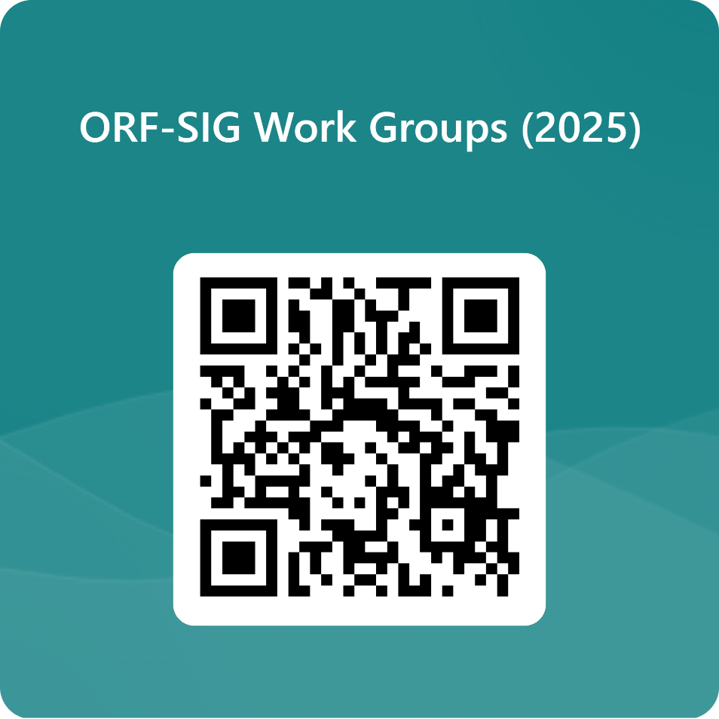
Ways to get involved

Slide 19
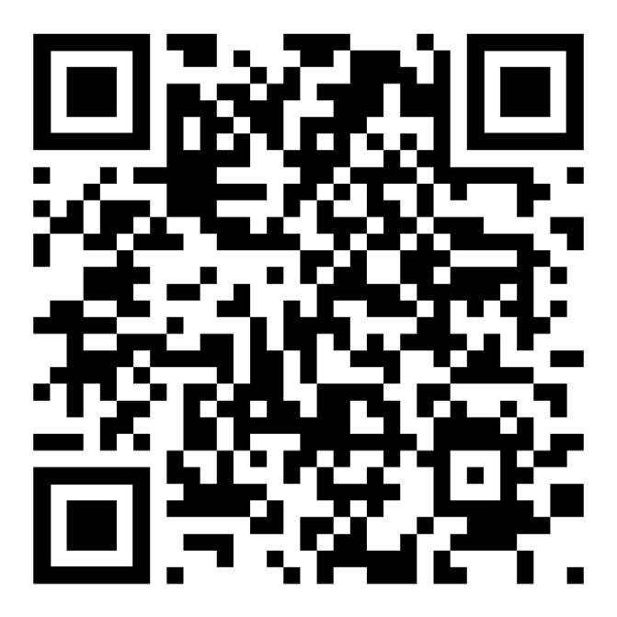
Member Communication-
ORF- SIG Facebook Group
https://www.facebook.com/groups/741598362644243
New program mentoring available:
Contact malloyma@arcadia.edu for assistance

Slide 20


Monthly Program Spotlight -
Successful October 2021 Launch
Each program will Spotlight a Faculty and/or Resident/FiT
Please visit: https://www.orthopt.org/content/special-interest-groups/residency-fellowship/orf-sig-program-spotlight/spotlight-program-faqs
Highlights how to submit your program
Can include video clips of residents/faculty etc.

Slide 21
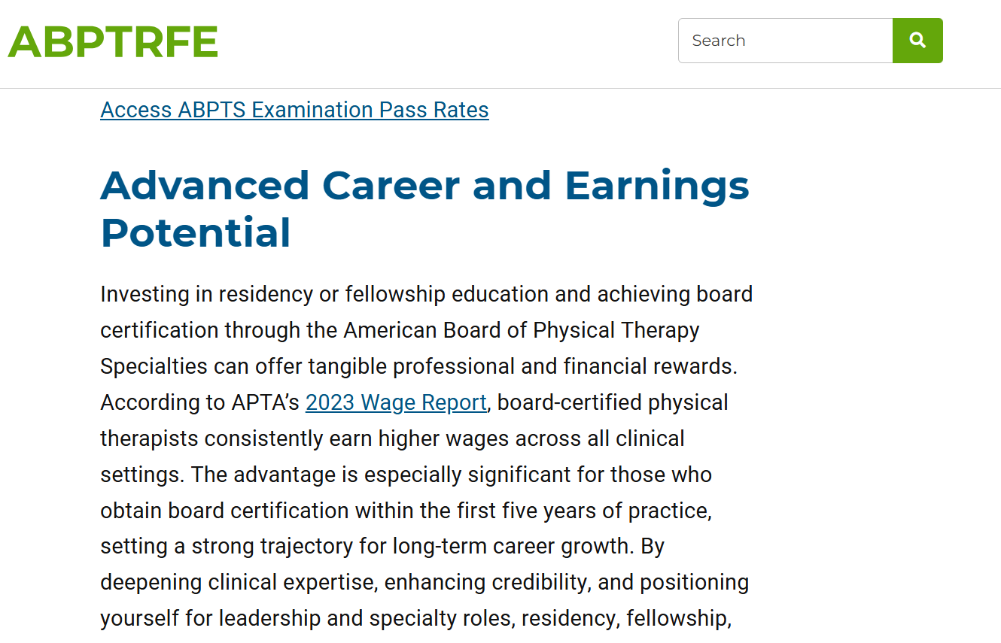
Marketing your program
Would a small group zoom be beneficial?
Strategies:
Marketing to students, DPT programs,
Showing value to employers

Slide 22
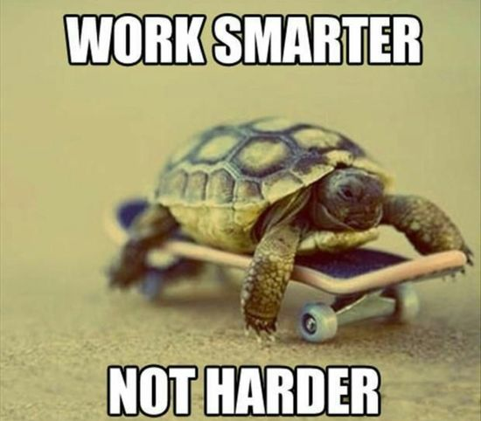
Open Discussion Future Planning - Molly
What are key areas you would like help with?

Slide 23
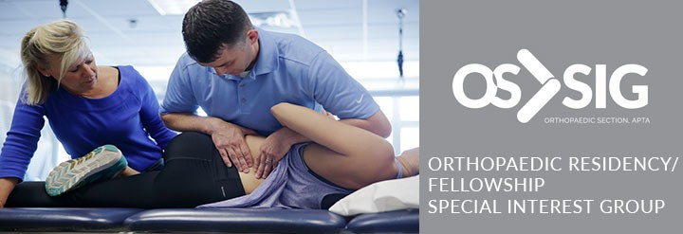
Thank you all malloyma@arcadia.edu

