Slide 1
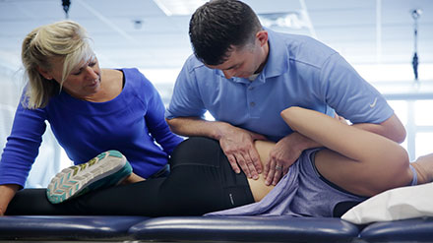
Academy of Orthopaedic Physical Therapy: ORF-SIG Business Meeting
A community of excellence in
Orthopaedic Residency and Fellowship Education
6/24/20

Slide 2
Agenda
10:00-10:05 - President’s Update
10:05-10:15 Committee Updates
Research Committee Update
Practice Committee Update
RFSIG Update
10:15-10:45 – COVID Resource Manual
Accreditation Updates
Ensuring Participant Completion
Program Sustainability
10:45-11:00 am
Questions and other items

Slide 3
Leadership
Board Liaison: Aimee Klein
Vice President: Kathleen Geist
Nominating Committee
Mary Derrick (Chair)
Robert Schroedter
Tyrees Marcy
Liaisons:
APTE RF-SIG: Christina Gomez
AAOMPT: Robert Schroedter
Committee Leads:
Research: Kathleen Geist, Mary Kate McDonnell
Practice/Reimbursement: Darren Calley
Membership: Bob Schroedter, Matt Stark
Communication: Kirk Bentzen, Kris Porter, Kathleen Geist
Sub-Committees:
ACAPT: Kirk Bentzen & Carrie Schwoerer
Curriculum: Molly Malloy, Kathleen Geist
Applicant Sharing: Steve Kareha, Kirk Bentzen
PD Admin Survey: Kathleen Geist, Steve Kareha, Kris Porter,

Slide 4
DASHBOARD (as of 6/22/20)
Total Members: 348 (+34)
Facebook Group: 116 (+8)
ABPTRFE ACCREDITED PROGRAMS:
Residencies:
Orthopaedic: 112 (+3)
Fellowships:
Hand: 0 (-2)
Movement: 2
OMPT: 27 (-8)
Performing Arts: 1
Spine: 3
Upper Extremity: 3
ACOMPTE ACCREDITED PROGRAMS
OMPT: 35
SCAN THIS CODE TO ACCESS THE SURVEY:

Slide 5
Disclaimer….
QR-Codes
Sooo……There’s a lot of them….
There for you to either scan with your phone…
OR….
Each also is a link if you click on the picture.

Slide 6
President’s Message- Moment of Silence
CoVid-19 Pandemic
Patients and their families
Healthcare providers
Public service members
Businesses and employees
Social Inequality
Members of society affected by social injustice
Our service men/women who seek to protect our public well being

Slide 7
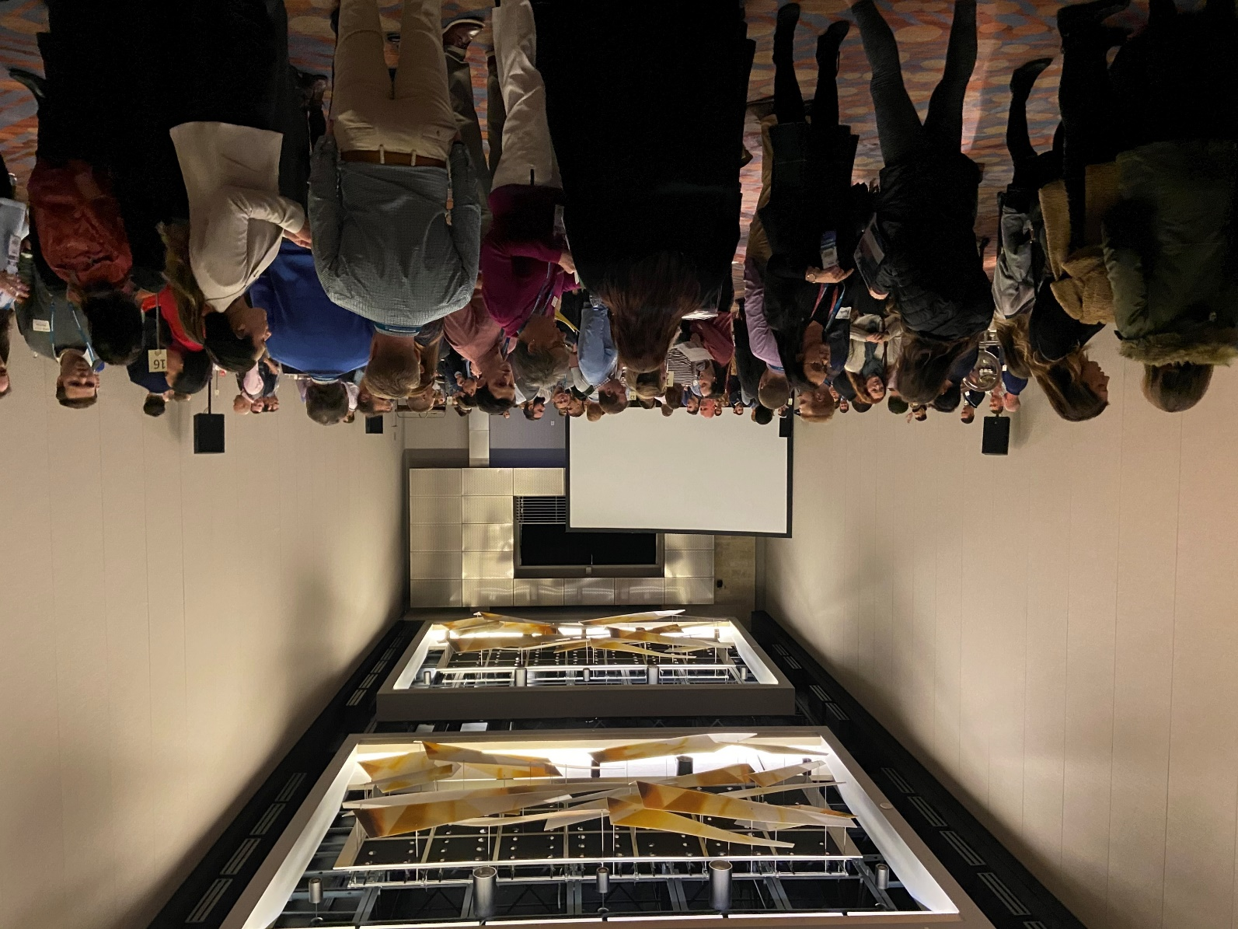
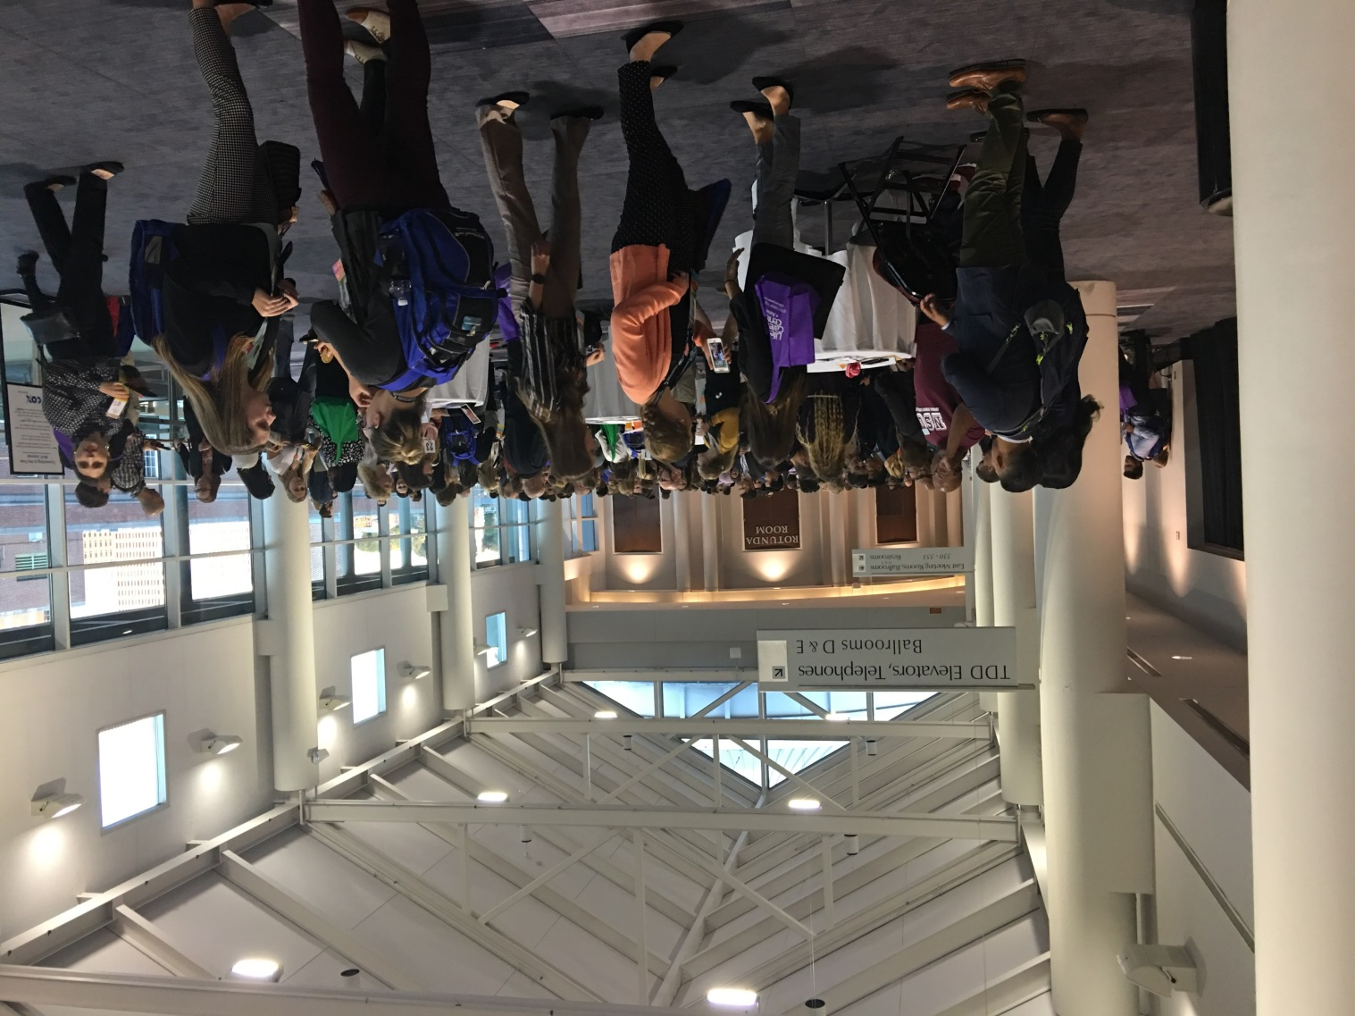
Looking Forward to 2021!
2020 ORF-SIG + AAOMPT Residency and Fellowship Career Reception
58 Programs in attendance
Look to provide again next year!
Welcome feedback on what we need to improve!
Notes:
ADD NEW PICTURE

Slide 8
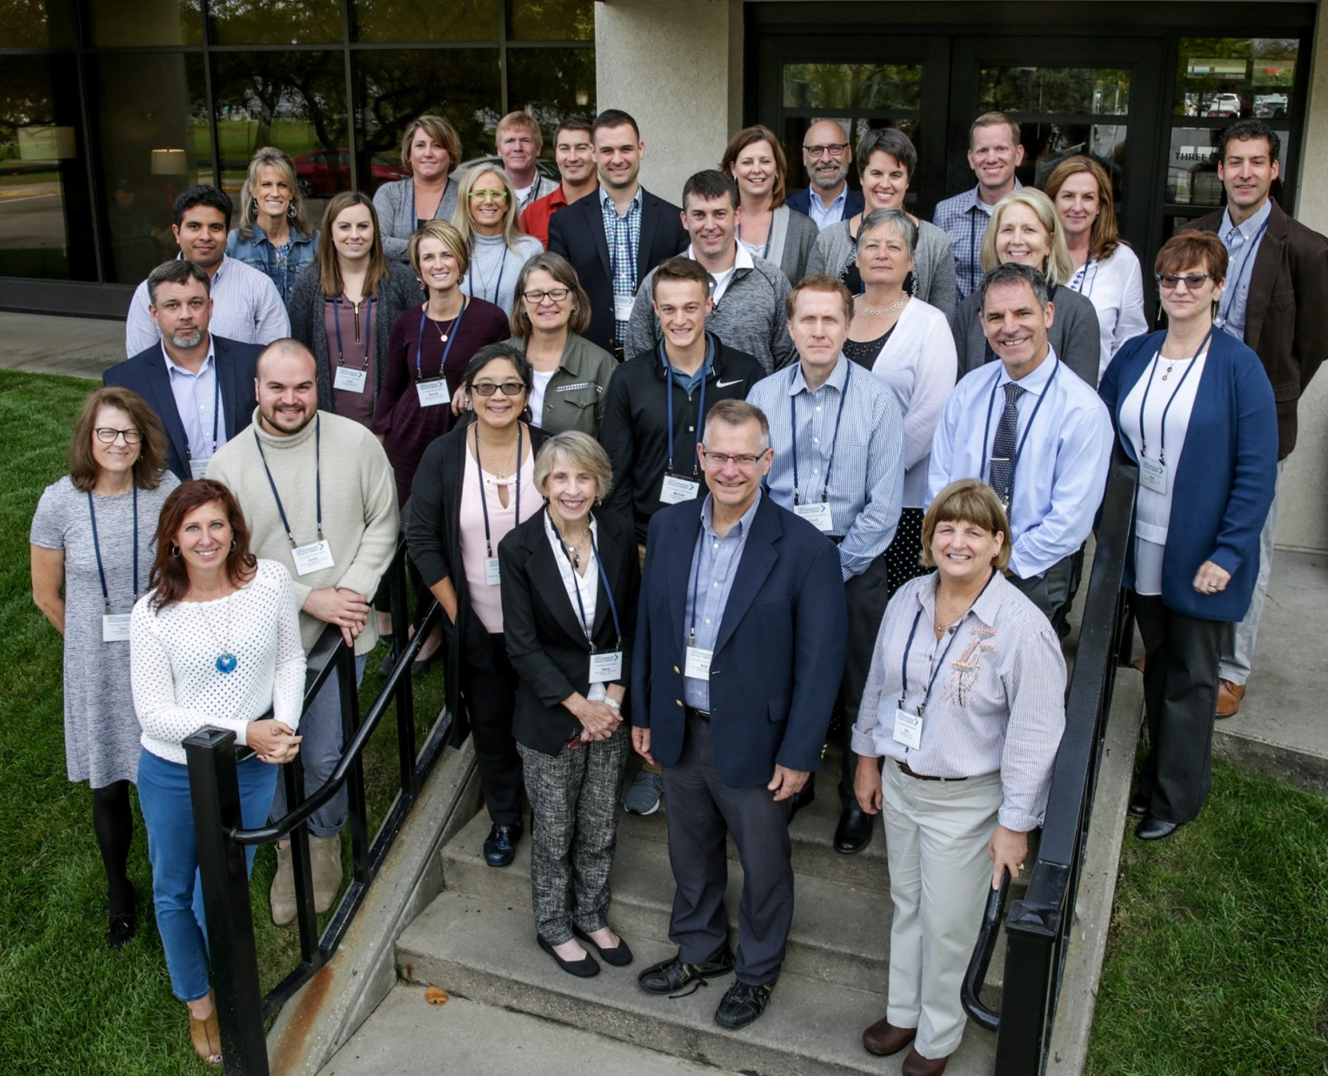
AOPT Strategic Planning- Looking Forward
NEW AOPT Mission, Vision, Strategic Initiatives and Goals
The ORF-SIG has realigned our Strategic Plan to match the new Mission, Vision and Goals of the Academy
Brought forth our Goals in how we are to achieve these

Slide 9
Vision Statement: The Academy of Orthopaedic Physical Therapy, will be a World leader in providing resources to optimize movement and musculoskeletal health
Mission Statement: The Academy of Orthopaedic Physical Therapy, empowers members to excel in orthopaedic physical therapy
Value and Payment
Positioning and Public Awareness
Position members as experts in managing movement and functional performance
Diversity and Inclusion
Increase the diversity of members, leaders and AOPT
Evidence to Best Practice
Promote development and implementation of evidence for best practice
Enhance payment for services by demonstrating the value of physical therapy

Slide 10
Newly Accredited / Re-Accredited Programs:
ABPTRFE Actions: May 17-18, 2020
New
Re-accredited
Residency: (+5)
Cincinnati VA Medical Center Orthopaedic Residency
Durham VA Orthopaedic Residency
Greater Los Angeles VA Orthopaedic Residency
Orthopaedic Residency of Foothills Physical Therapy
Palmetto Health Orthopedic Residency
Fellowship:
Residency:
Foothills Sports Medicine Orthopedic Residency
Stanford Healthcare Orthopaedic Residency
VA Eastern Colorado Health Care System Orthopaedic Residency
Fellowship

Slide 11
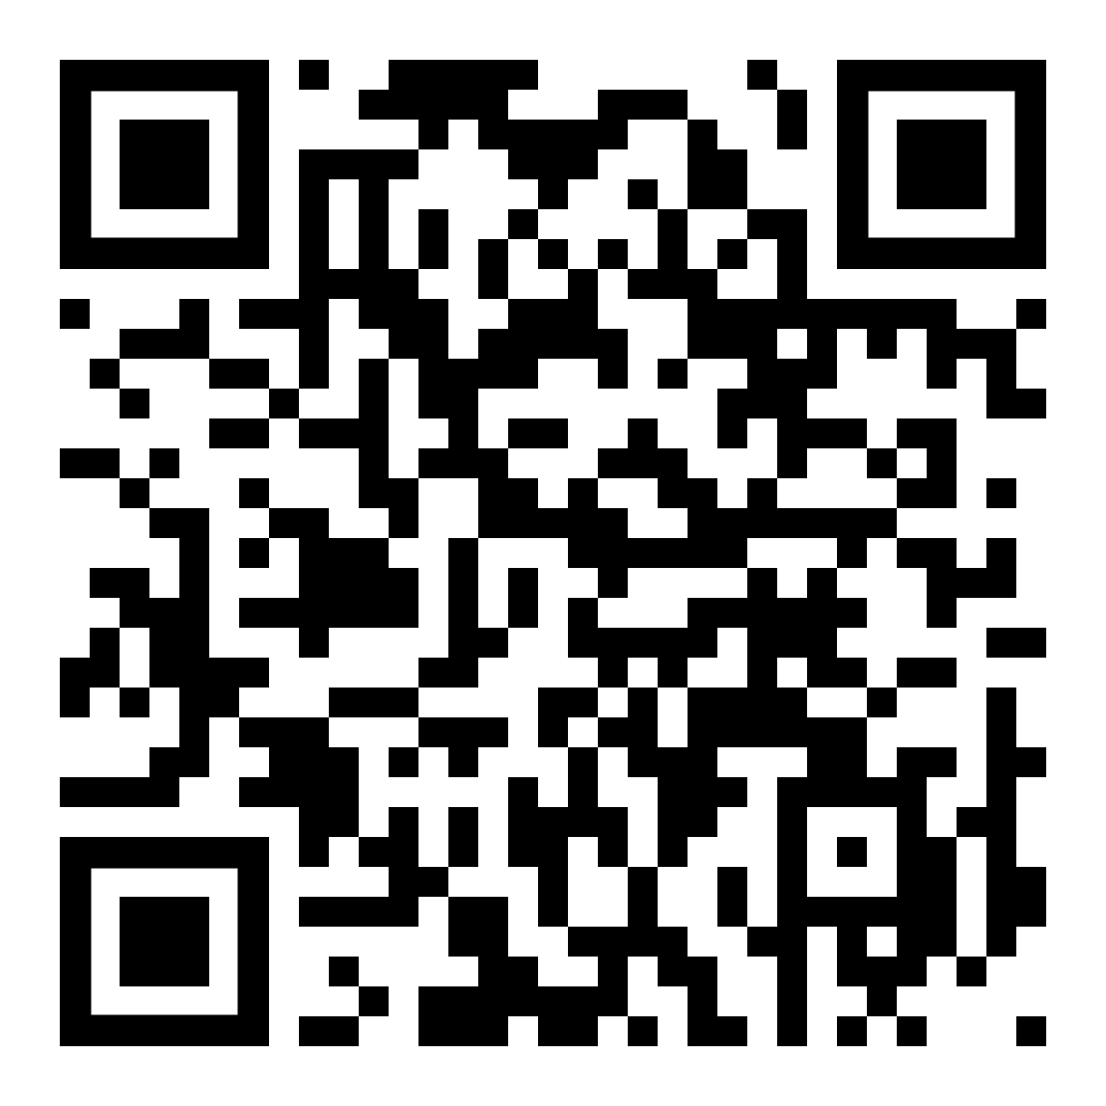
ABPTRFE Update:
Held May meeting with recent action posted on the HUB
CoVid-10 Response doc posted on Hub
Working on 13.5 doc updates after feedback

Slide 12
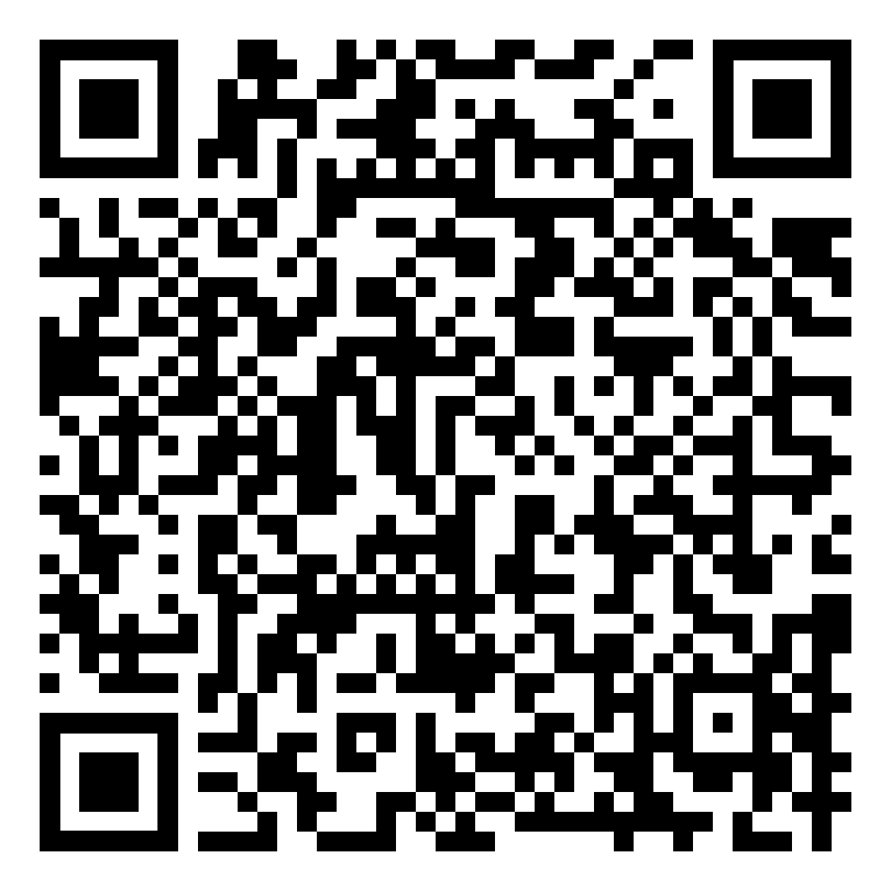
ORF-SIG & RFESIG Collaboration- Christina Gomez
COVID-19 Podcast
Part One. Current Resources for R/F programs
Matt Haberl- Chair, ORF-SIG
Kathleen Geist- Vice-Chair, ORF-SIG
Linda Csiza- Lead Accreditation Specialist, APTA
Jim Moore- University of Miami
Available now!

Slide 13
ORF-SIG & RFESIG Collaboration
COVID-19 Podcast
Part Two. Looking to the Future
Elaine Lonnemann- President, AAOMPT
Cameron MacDonald- Regis University
Mark Shepherd- Bellin College
*Special appearance by Matt Haberl
Stay Tuned!

Slide 14
Research Committee: Kathleen Geist
2020 CSM Pre-con course: 64 Attendees!
Beyond the Basics: Design and implementation of best practice in residency and fellowship clinical education:
Kirk Bentzen, Aimee Klein, Tara Jo Manal, Eric Robertson, Matt Haberl, Kathleen Geist
2021 CSM Presentation Proposals Due!
Education sessions proposals (extended submission deadline: April 1, 2020)
Poster and platform abstracts (submission deadline: July 13)

Slide 15
Research Committee: Kathleen Geist
Orthopaedic Practice Research Submissions
Scholarly Activities- 2 per year
Resident/Fellowship Case report, Res/Fellowship Research, Survey outcomes
2020 OP Deadlines:
February 7 for April 2020
May 8 for July 2020
August 7 for October 2020- Research Publication
January 2021- Research Publication
Working with AOPT Awards committee and Research committee in having two CSM Poster Presentation Winners
Treatment of Non-Sports Related Concussion in Adolescents Utilizing Tissue Irritability Algorithmic Approach: A Case Series, Dr. Lindsay Walston, Dr. Zach Walston
Consideration of Health Literacy and Acculturation in a Non-Native English-Speaking Patient: A Case Report: Dr. Marlon Wong
Goal: Have two award winners every year
Prize: $250 if they develop into full publication for OP.
Notes:
JOSPT is pushing the Res/Fellowship Community to publish more cases.

Slide 16
Practice/Reimbursement Committee:
Mentorship Survey!
Keep an eye on your email for Survey evaluating best strategies in mentorship!

Slide 17
ACAPT Update
Previous issue – students in terminal affiliation taking time off to go interview for residency slots. DPT programs and clinical partners had conflicting perspectives compared to residency programs.
New reality
Travel and in-person interviews may be on hold for a long time during COVID pandemic
Virtual interviewing and/or phone interviews are the most common option right now
Many residency programs are still in an ‘on-hold’ status due to the pandemic
Many DPT programs are struggling with clinical affiliation sites closures due to the pandemic and the need to go virtual with DPT instruction – the previous issue listed above may recede into a non-issue?

Slide 18
CoVid 19 Resource Manual
Thank You: Kirk Bentzen, Kathleen Geist, Steven Kareha, Molly Malloy, Carrie Schwoerer, Megan Frazee
Table of Contents
Accreditation Interim Standards
ABPTRFE / ACOMPTE
Ensuring Participant Completion
Change in Educational Delivery
Utilization of Telemedicine
Program Sustainability
Applicant and Program Sharing
Alt. Financial Resources

Slide 19
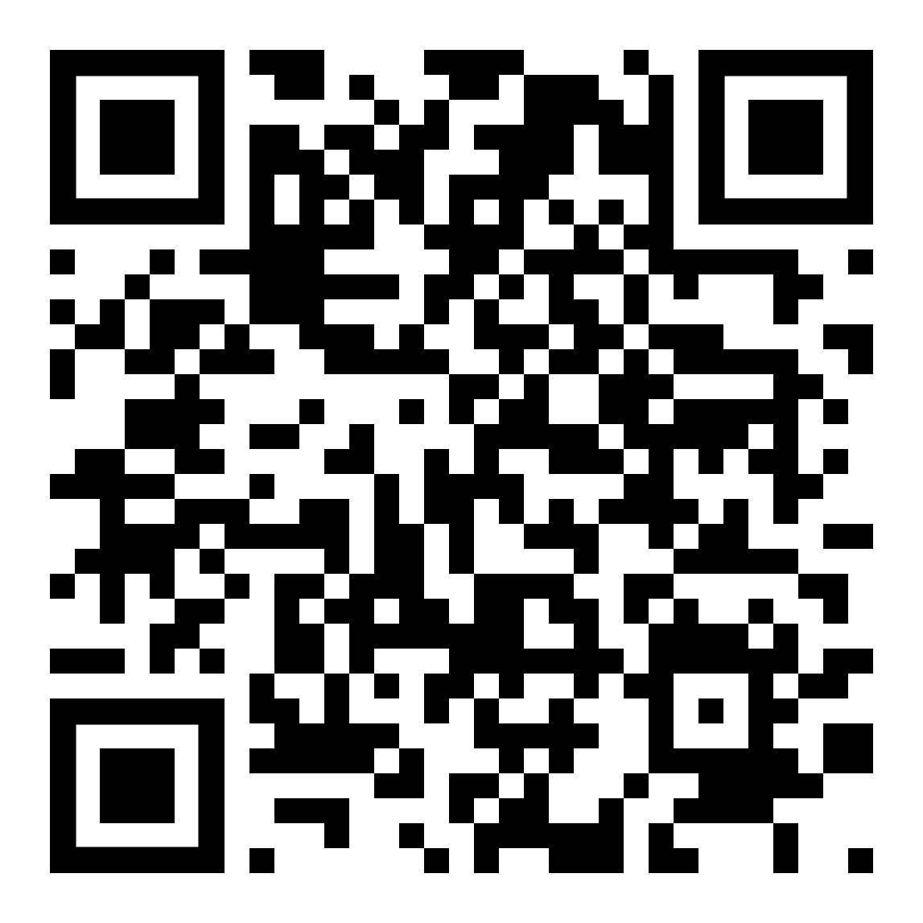
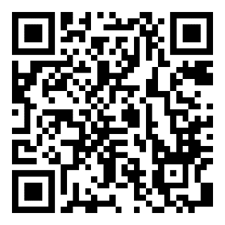
CoVid-19 Communication
ORF- SIG Facebook Group
AOPT ORF-SIG Communities HUB

Slide 20
ABPTRFE Standards- Kirk Bentzen
Program waivers for the following:
Practice Settings
Practice Hours
Mentoring Hours
Faculty Evaluations
Other Program Outcomes
Recommended use of online, remote or virtual technologies
Temporary guidance during the pandemic only

Slide 21
ACOMPTE Interim Standards- Kirk Bentzen
Program modification: ​
Time Extension
Educational Hours​
Required Practice Setting
Curriculum Changes
Practice Hours
Mentoring Hours​
Faculty Evaluations
Temporary guidance during the pandemic only

Slide 22
Program Sustainability: Participant Completion- Kathleen / Molly
Guidelines for return to classrooms and lab resources: ACAPT
https://acapt.org/docs/default-source/public-docs/acapt-classroom-and-lab-guidelines-work-plan---version-1-may-18-2020.pdf?sfvrsn=49a08cd8_4
Prevention, handling of ill or recovering individuals, curricular designs, support services
Mitigation of risk (New guidelines)
https://www.cdc.gov/coronavirus/2019-ncov/community/colleges-universities/considerations.html
- Provides CDC guidelines for Institutes of Higher Education guidelines cleaning, signage,
- Lowest risk: online teaching
- Moderate risk: small group classes and labs, maintaining 6 feet distance when possible and limiting time of the exposure. Options are wearing face sheilds and masks during lab – regardless of symptoms or known exposure.
Contact malloyma@arcadia.edu if you need assistance with policies for return to residency activities

Slide 23
Program Sustainability: Applicant Completion- Mike Bourassa- ACF-SIG Manual Therapy Document
Resource sheet with platforms for teaching manual therapy in the online world
Flip grid for discussion tools related to teaching in the online world
https://flipgrid.com/aaomptacfsig2020
OCS case discussion board
4-part post to gain 1 MOSC credit
Residency/Fellowship Reach out email
Questions: Jodiyoung2@gmail.com

Slide 24
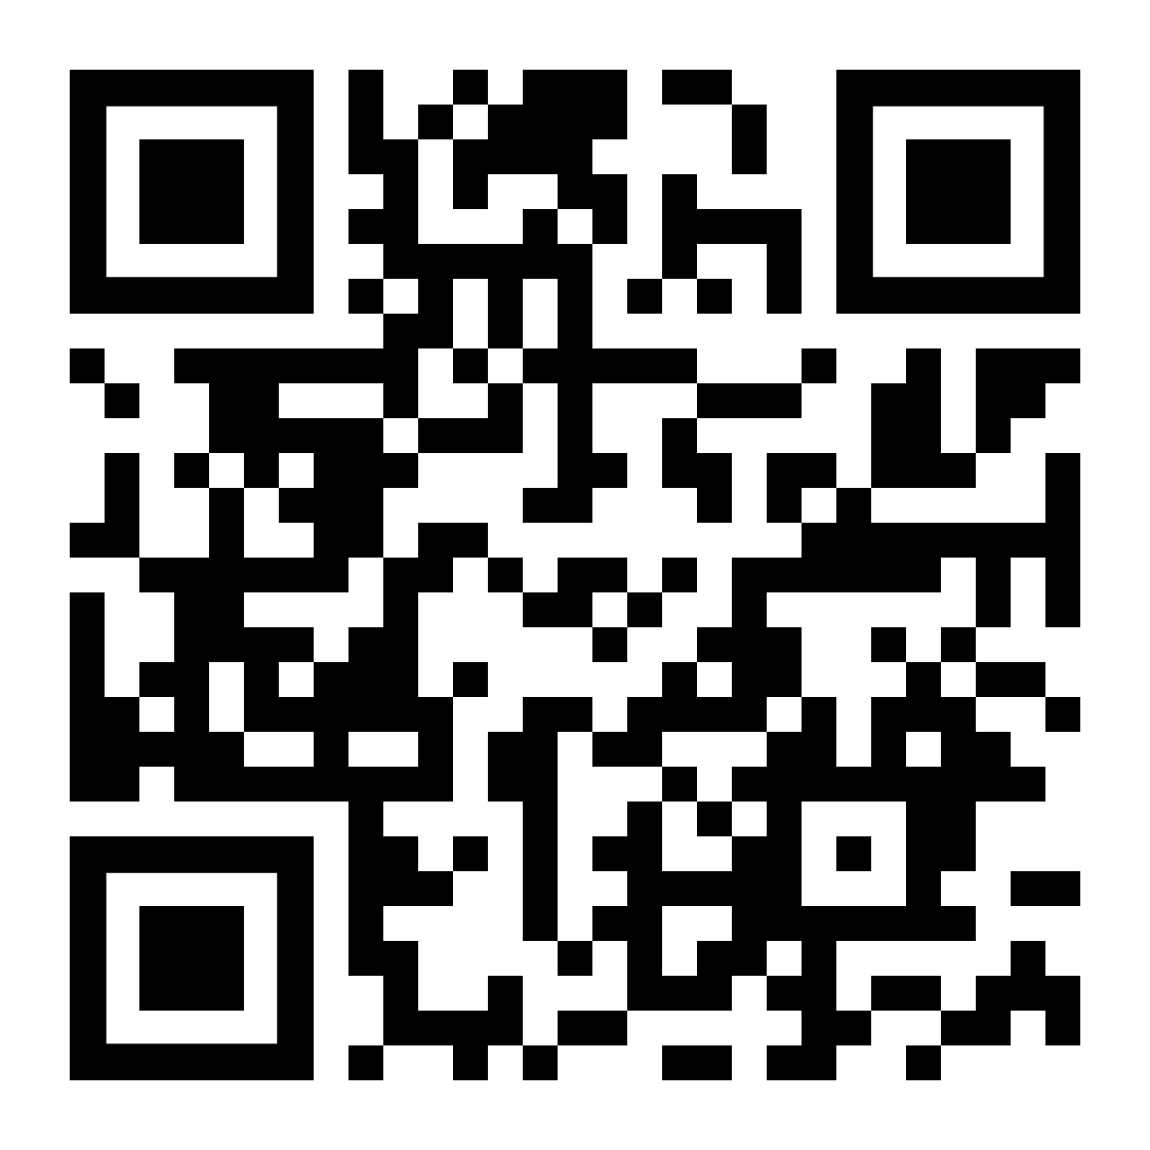
CoVid-19 Communication
ORF-SIG Flipgrid- Kathleen/ Molly
Create a platform via Flipgrid to connect members and share information
Will need to link through the ORF-SIG website or advertise via FB, e-blasts
AAOMPT ACF-SIG Flipgrid site

Slide 25
Program Sustainability: Applicant Sharing- Steve Kareha / Kirk Bentzen
RF-PTCAS:
For Programs that fill their positions-
Redirect applicants back to RF-PTCAS to look for programs still accepting applications
Ask if they would like programs to reach out to them. If they do ask that they complete the attached survey link.
Provide the applicant with the Program Information
Programs still needing to fill positions after initial deadline
Re-open their applications after their deadline should they have slots still open. This is done by:
Update the deadline in the RF-PTCAS Configuration Portal, or reaching out to Courtney Merritt at RF-PTCAS to assist with this
Updating the deadline in the ABPTRFE Directory to prevent discrepancies
It is advised that programs select “Rolling” as the new display date for their deadline after re-opening, as they are accepting new applications and reviewing them on a rolling basis until all slots are full
Additionally, access the Program Information Google Drive Sheet with the email linked to your APTA ORF-SIG Membership
Interested Residents contact information can be found here.
Notes:
Need new content

Slide 26
Program Sustainability: Applicant Sharing- Steve Kareha / Kirk Bentzen
NON - RF-PTCAS Users:
For Programs that fill their positions-
Redirect applicants to RF-PTCAS to look for programs still accepting applications
Ask if they would like programs to reach out to them. If they do ask that they complete the attached survey link.
Provide the applicant with the Program Information
Programs still needing to fill positions after initial deadline
Access the Program Information Google Drive Sheet with the email linked to your APTA ORF-SIG Membership
Interested Residents contact information can be found here.
Notes:
Need new content

Slide 27
Program Sustainability: Applicant Sharing
Applicant Survey Link
Program Information

Slide 28
Open Floor
What else do Program’s need?

Slide 29
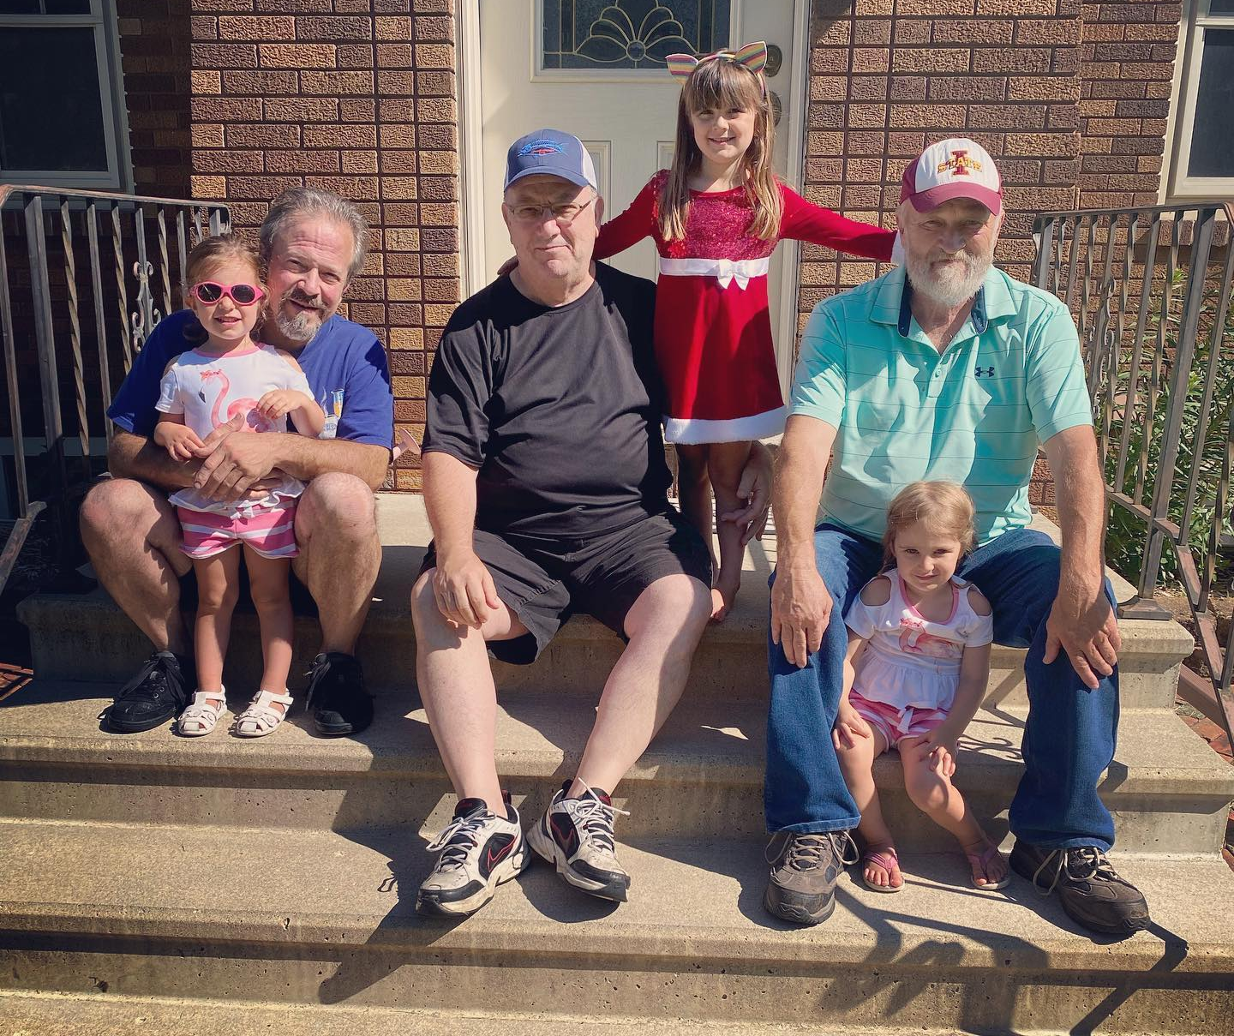
Thank You!
Don’t forget next SIG meeting
August 19^{th,} 2020 @11 am CST
November 11^{th,} @ Noon CST

