Slide 1
Save the Date(s)
2/12/20 8:00am-5:00pm: Pre-Conference Programming: Clinical excellence in residency and fellowship education
2/12/20 7:00-8:30pm: AOPT Special Interest Group Meet and Greet
2/13/20 8:00-9:30pm: Ortho Res/Fellowship Career Reception
2/15/20: 7:00-7:45am: ORF-SIG Business Meeting
NOTE: As you log on please mute your self.

Slide 2
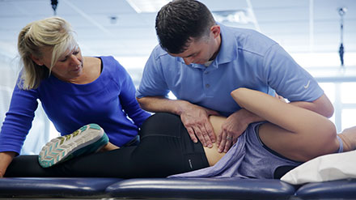
Academy of Orthopaedic Physical Therapy: ORF-SIG Business Meeting
A community of excellence in
Orthopaedic Residency and Fellowship Education
11/6/19

Slide 3
Leadership
Board Liaison: Aimee Klein
Vice President: Kathleen Geist
Nominating Committee
Melisa Dreger (Chair)
Mary Derrick
Robert Schroedter
Liaisons:
APTE RF-SIG: Christina Gomez
AAOMPT: Robert Schroedter
Committee Leads:
Research: Kathleen Geist, Mary Kate McDonnell
Practice/Reimbursement: Darren Calley
Curriculum: Molly Malloy, Kathleen Geist
Membership: Bob Schroedter, Matt Stark
Communication: Kirk Bentzen, Kris Porter, Kathleen Geist
Sub-Committees:
ACAPT: Kirk Bentzen & Carrie Schwoerer
Mentor Development: Kris Porter, Carol Jo Tischner, Matt Haberl
Applicant Sharing: Steve Kareha, Kirk Bentzen
PD Admin Survey: Kathleen Geist, Steve Kareha, Kris Porter,

Slide 4
Agenda
12:00-12:10 – President’s Update
12:10-12:15 - ABPTRFE Update
12:15-12:25 Sub-Committee Updates:
Applicant Sharing
ACAPT White Paper
Administration Survey
12:25-12:40 Committee Updates
Curriculum Committee Update
Research Committee Update
Membership Committee Update
Practice Committee Update
12:40-12:50 am Liaison Updates
RFSIG Update
AAOMPT Update
12:50-1:00
Questions and other items

Slide 5
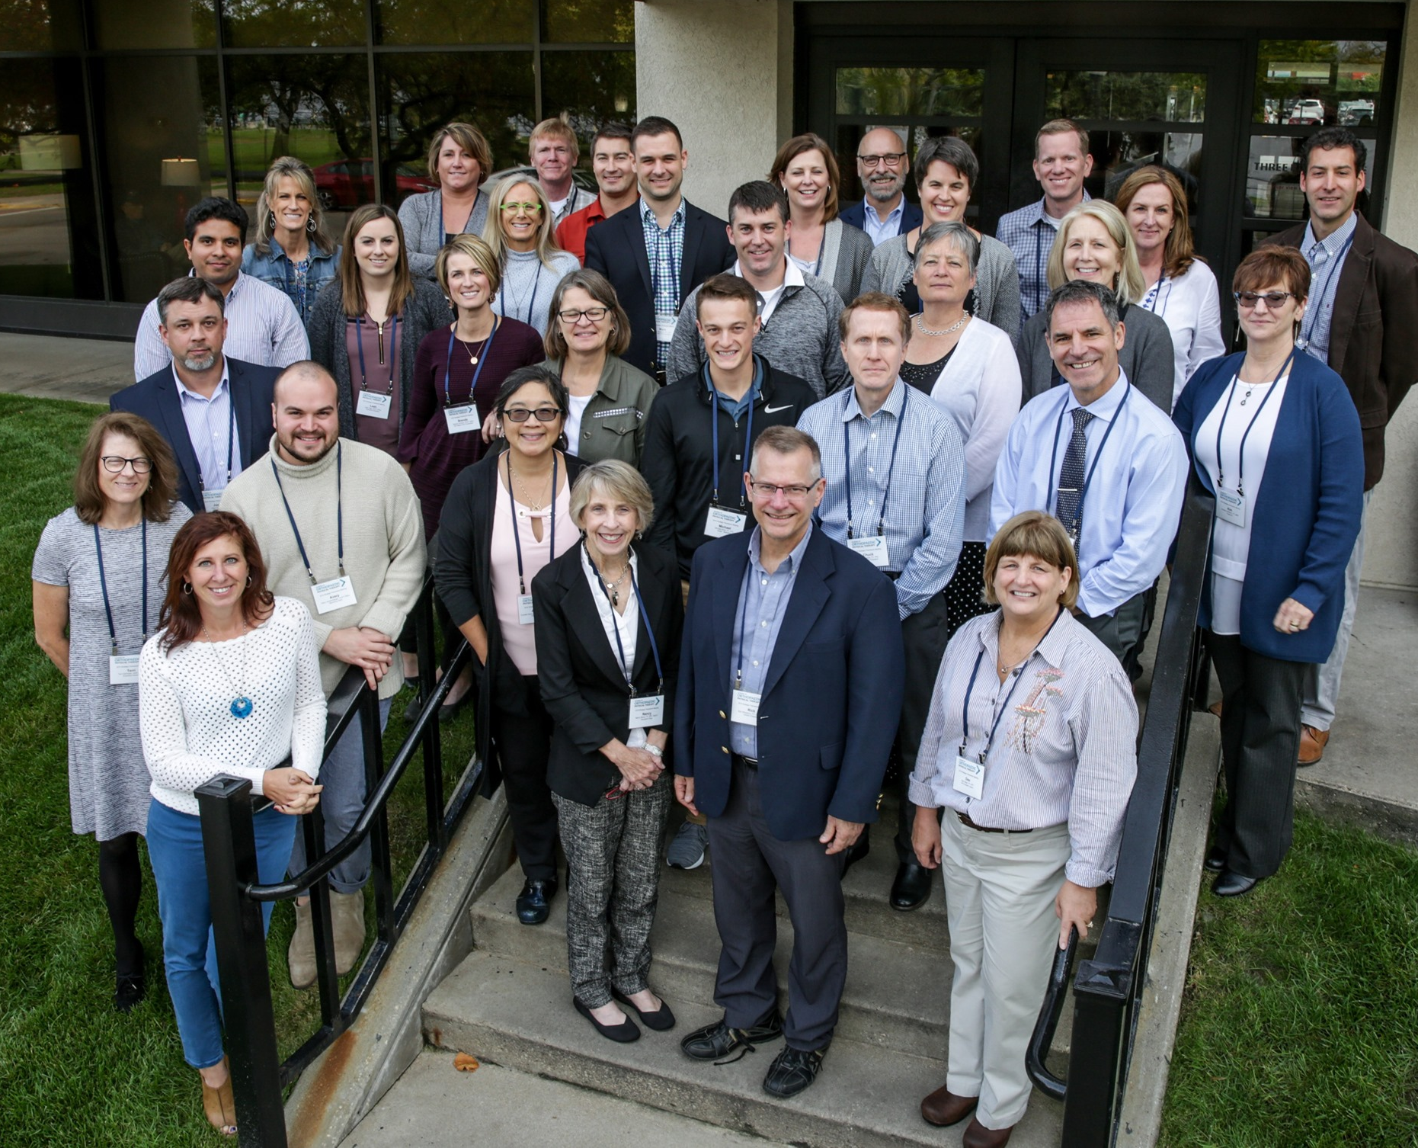
President’s Update
AOPT Strategic Planning took place on Oct. 9-12 in La Crosse, WI
Look for the unveiling of a new Mission, Vision, Strategic Initiatives and Goals at CSM
Thank you to Michael Borst, current resident who attended as a guest to represent our newer membership and advocate for residency and fellowship education

Slide 6
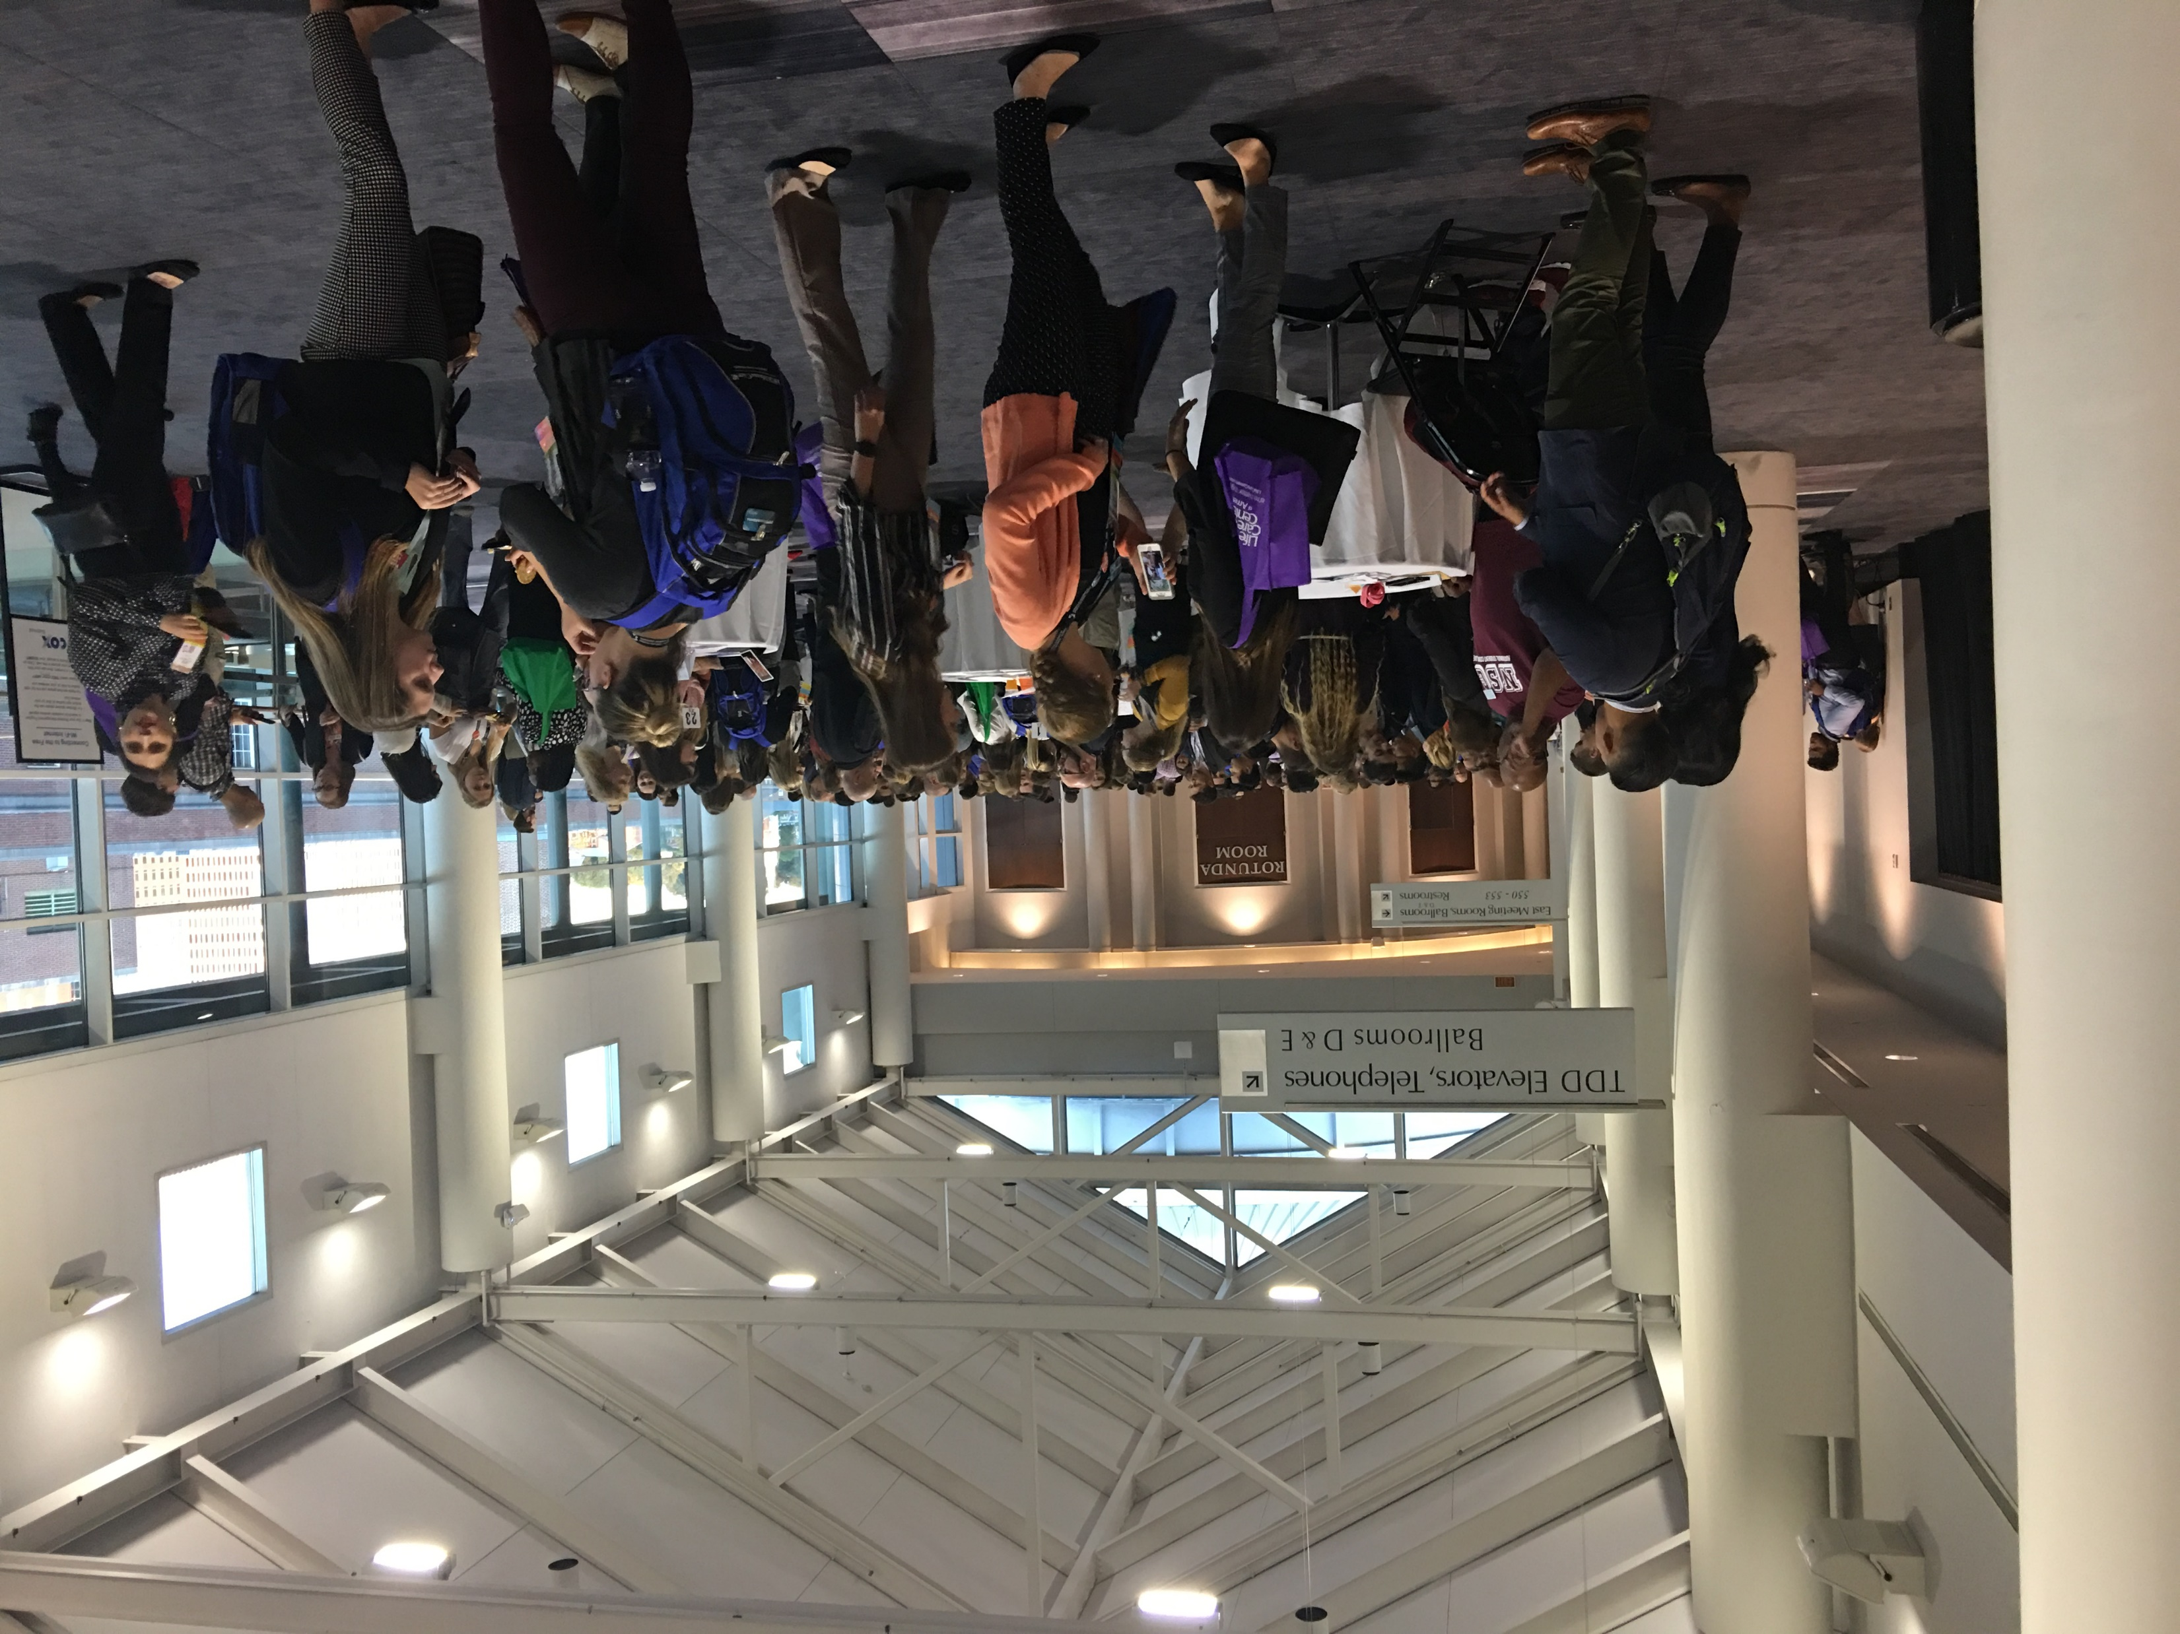
CSM: Residency and Fellowship Career Reception
When: Thursday, February 15th
Time: 8:00-9:30 pm
Where: Combined Sections Meeting- Denver, CO
Set up: Reception style table
Cost Share: $75
RSVP: November 18^{th,} 2019
More Info: contact Tara Fredrickson
tfred@orthopt.org

Slide 7
DASHBOARD
Total Members: 303
Facebook Group: 106
Future: To have breakdown of member demographics
ACCREDITAED PROGRAMS:
Residencies:
Orthopaedic: 110
Fellowships:
Hand: 2
Movement: 2
OMPT: 34
Spine: 2
Performing Arts: 1
Upper Extremity: 3

Slide 8
Newly Accredited / Re-Accredited Programs:
New
Re-accredited
Residency:
Physical Therapy & Sports Medicine Centers Orthopaedic Residency
Holy Cross Hospital Orthopaedic Residency
Mercy Health - Cincinnati Orthopaedic Residency
University Hospitals Orthopedic Residency
Fellowship:
University of Delaware Orthopaedic Manual Physical Therapy Fellowship
East Tennessee State University Orthopaedic Manual Physical Therapy Fellowship
Residency:
Memorial Hermann Orthopedic Residency
Malcom Randall VA Medical Center Orthopaedic Residency
Mayo Clinic Orthopaedic Residency
Arcadia University Orthopaedic Residency
Drexel University Orthopaedic Residency
Fellowship
ATI Physical Therapy Upper Extremity Athlete Fellowship

Slide 9
Foot/Ankle Practice Analysis- Kris Porter
Foot/Ankle Fellowship: FASIG is seeking ABPTRFE recognition
Task Force: Surveyed AOPT members > formed 15 member Task Force
Needs Analysis: Surveyed Residency/Fellowship Program Directors for Needs Analysis
Grant: AOPT for Practice Analysis is under review ($10,000-15,000)
Practice Analysis Survey: dividing and conquering with task force
Survey based on Performing Arts Fellowship (the first one under new Petition system)
DFP: Goal is to write this within ~ 1 year
Principal Investigators: Kris Porter, Marcey Keefer Hutchison and Christopher Neville
Is your organization interested in a foot/ankle fellowship?

Slide 10
ABPTRFE Update:
Res/Fellowship Career Reception at NSC cancelled
RF-PTCAS hosted Virtual Res/Fellowship Career Fair 9/24/19
Will be annually – 30 institutions represented 90 programs
Not highly attended- looking to better market next year
All should have received Annual Continuous Improvement Reports Feedback

Slide 11
ABPTRFE Update: From the HUB
Policy 13.4.2 Update from Kim Curbow Wilcox, Chair ABPTRFE
June: Standards Committee reviewed the suggestions from April Stakeholder meeting
Sub-group of ABPTRFE members reviewed the recommendations over the summer to develop and evaluate options, gather information and consult legal counsel
Work brought to the ABPTRFE Sept. Board Meeting were it was determined that further research was needed and will further evaluate at January 2020 meeting.
Continue to evaluate alternatives to the in-person onsite visit as well as the process.
The Proviso for policy 13.4.2 remains intact
Will hold a public comment period on the final proposed changes prior to adopting a revised policy.
List of Program Actions can be found on the HUB / ABPTRFE Website

Slide 12
Sub-Committee Updates
Applicant Sharing Sub-Committee: Steve Kareha
Lead: Steve Kareha (Stephen.Kareha@sluhn.org); Kirk Bentzen
Res/Fell Leadership team met with Ryan Bannister
Understand how to better utilize RF-PTCAS
Since it is applicant driven trying to assist applicants that get turned away from positions to still access those who are still accepting.
Also- Programs can turn on or off their deadlines if applicants not accepted.
Not planning on doing anything further from a PD standpoint like other programs have.
ACAPT White Paper Sub-Committee
Kirk Bentzen, Carrie Schwoerer, Carol Beckel, Tiffany Enache, Mary Milidonis
Goal: Bring awareness to the unique issues facing all levels of the professional development continuum
Plans to present at ELC 2020
Timeline to meet this goal in progress
Notes:
Can

Slide 13
Sub-Committee Updates: PD Survey- Kathleen Geist
Identified concerns from Fellowship programs:
ABPTRFE/IFOMPT reporting and maintaining accreditation standards
clinical mentoring with fellows-in-training (FIT) and faculty
admissions and recruitment, coordination of fellowship coursework/curriculum and communication with faculty, mentors, and fellows
Identified concerns from Residency programs:
Residency programs identified difficulties in the provision of administrative tasks to include a significant time commitment
financial constraints of non-productive time without passing the expense onto the current resident
lack of budgetary and administrative support from the primary residency institution

Slide 14
Curriculum Committee Update- Kathleen Geist
Curriculum Task Force: Leads- Molly Malloy & Kathleen Geist
Members: Linda Dundon, David Morrisette
Based on a review of the DRP/DFP, the following recommendations were made for the publication of new ISC’s:
Pain Science to include the biopsychosocial influences on pain
Motor Control/movement analysis
Lab Values/EMG
Pediatric Orthopaedic Physical Therapy/Growth and Development Across the Lifespan.
AOPT BOD have added the two ISC’s to the Residency Package to meet new DRP
Screening for Orthopaedics
Outcomes in Orthopaedic Practice
$500

Slide 17
Research Committee: Kathleen Geist
CSM Pre-con course: Feb. 12th
Beyond the Basics: Design and implementation of best practice in residency and fellowship clinical education:
Kirk Bentzen, Aimee Klein, Tara Jo Manal, Eric Robertson, Matt Haberl, Kathleen Geist
Submitted a letter for support from the SIG and AOPT in collaboration with the Education-RF-SIG
“Defining Excellence in Residency Education: The Next Step in Demonstrating Value.”
Matt Briggs, Raine Osborne, Sara Kraft, Mary Jane Rapport, Lisa Black, Carol Jo Tichenor, Greg Hartley, Gail Jensen

Slide 18
Research Committee: Kathleen Geist
Orthopaedic Practice Research Submissions
Scholarly Activities- 2 per year
Resident/Fellowship Case report, Res/Fellowship Research, Survey outcomes
2020 OP Deadlines:
February 7 for April 2020
May 8 for July 2020
August 7 for October 2020
Working with AOPT Awards committee and Research committee in having two Poster Presentation Winners
Goal: Have two award winners every year
Prize: $250 if they develop into full publication for OP.
Notes:
JOSPT is pushing the Res/Fellowship Community to publish more cases.

Slide 19
Communications Committee:
Members of the ORF-SIG: Brook Janicky, Matt Haberl, Kathleen Geist, Kirk Bentzen, Kris Porter, & Tom Denninger
Provided an impact analysis of the policy and procedure review which served as an appendix to a letter of concern drafted by the AOPT Board
Complete letter found on Facebook Group

Slide 20
Membership Committee- Kathleen Geist
National Student Conclave- Kathleen Geist, VP
Albuquerque, NM: Supported AOPT membership, highlighted student benefits, and promotion of residency education
Shaker bottles and koozies were very popular among conference attendees

Slide 21
Membership Committee- Bob Schroedter
Member Engagement
Surveying our current members to understand their role in Res/Fellowship Education
Looking for 100% PD involvement
Of Members
>50% to be Faculty
> 10% to be aspiring/current Res/Fellows
Email Contacts:
Will be cross referencing email list with membership status. May be receiving emails asking you to become a member if current email is not registered as an ORF-SIG/APTA Member
Communication in the future will be limited to only members come 2020
Website: Program side live now!

Slide 22
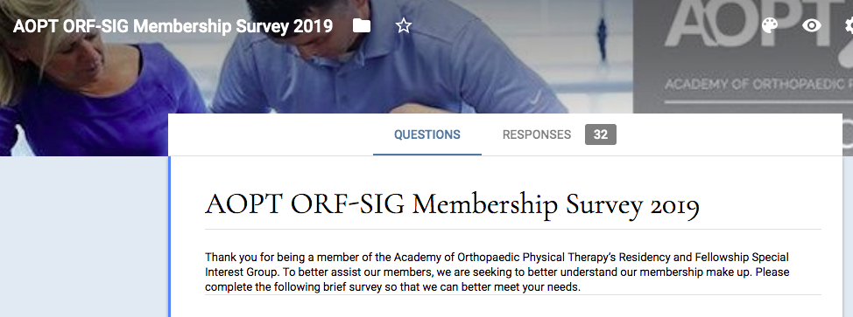

Slide 23
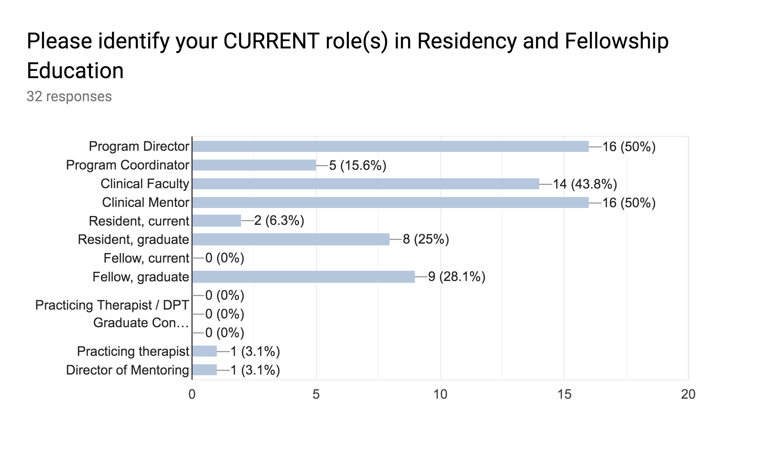

Slide 24
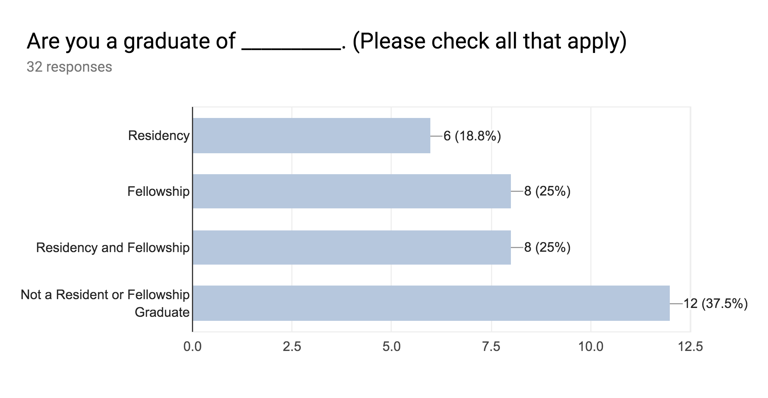

Slide 25
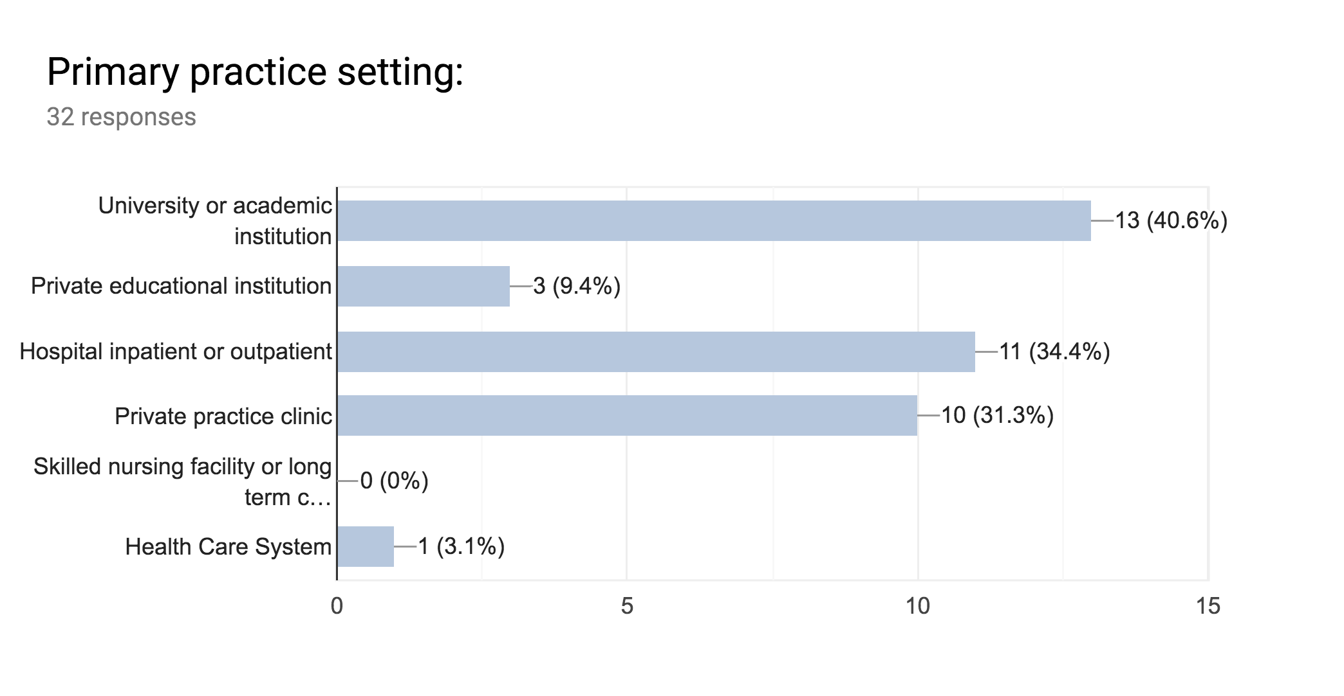

Slide 26
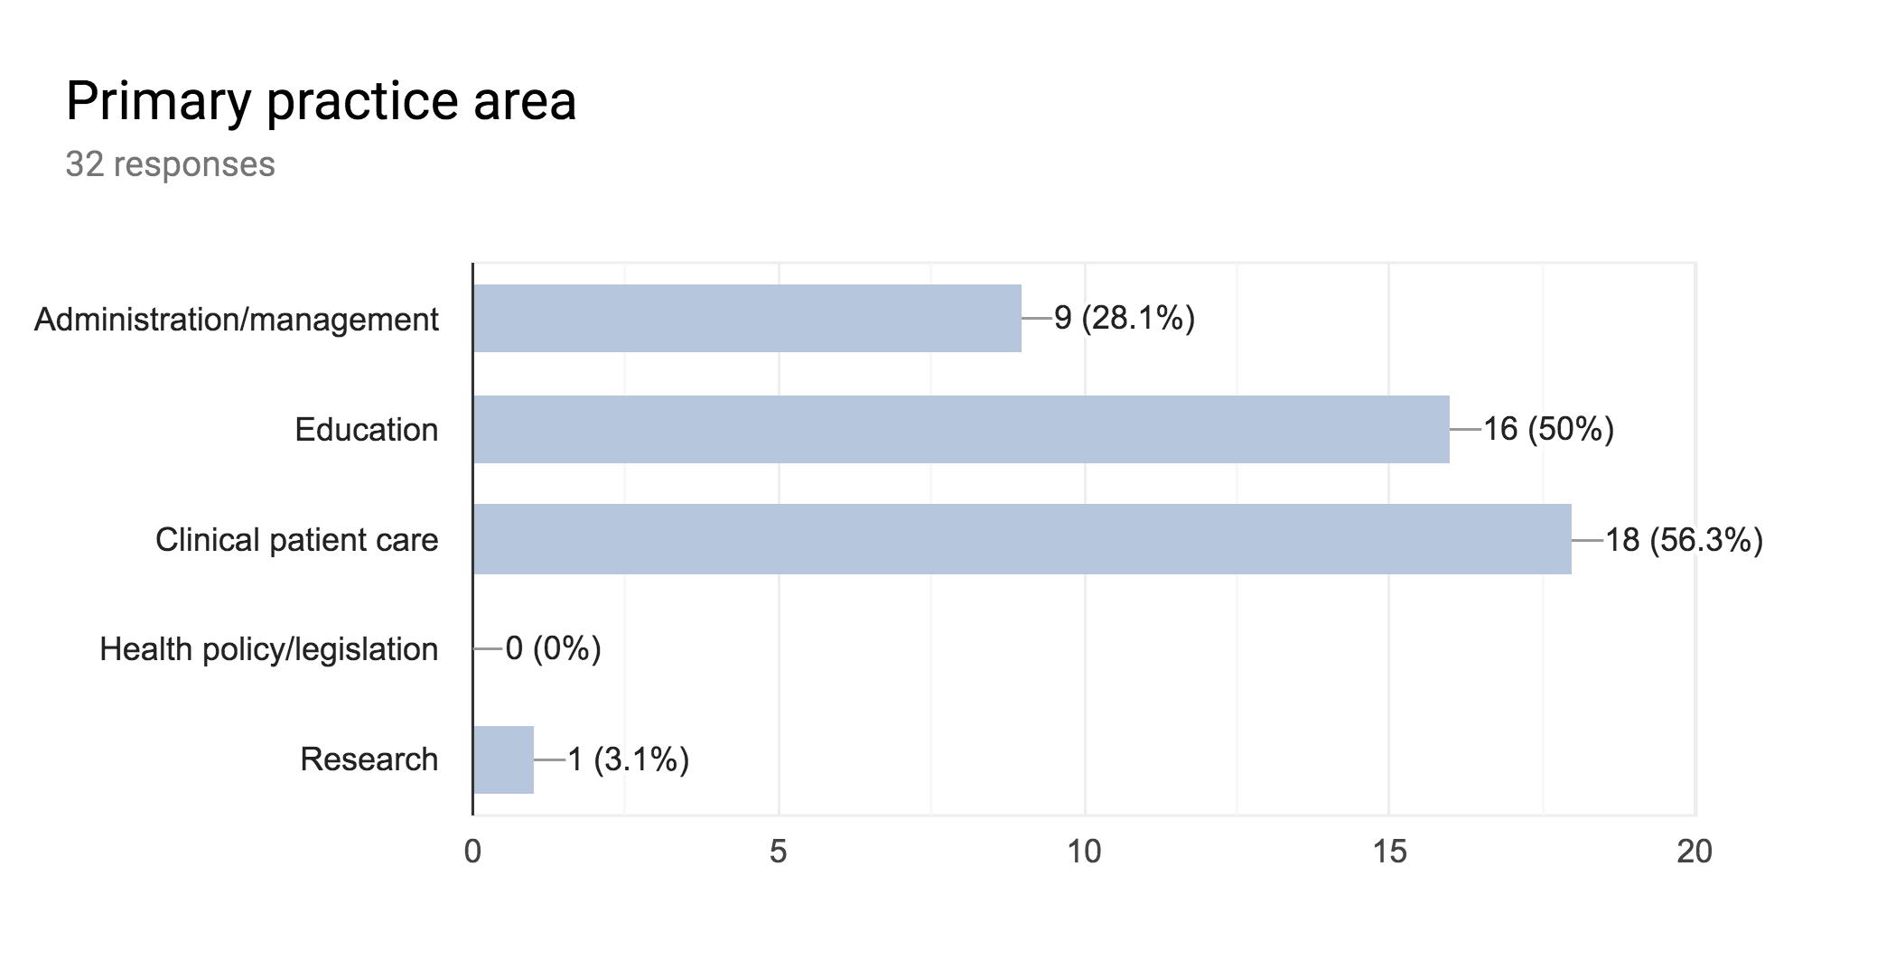

Slide 27
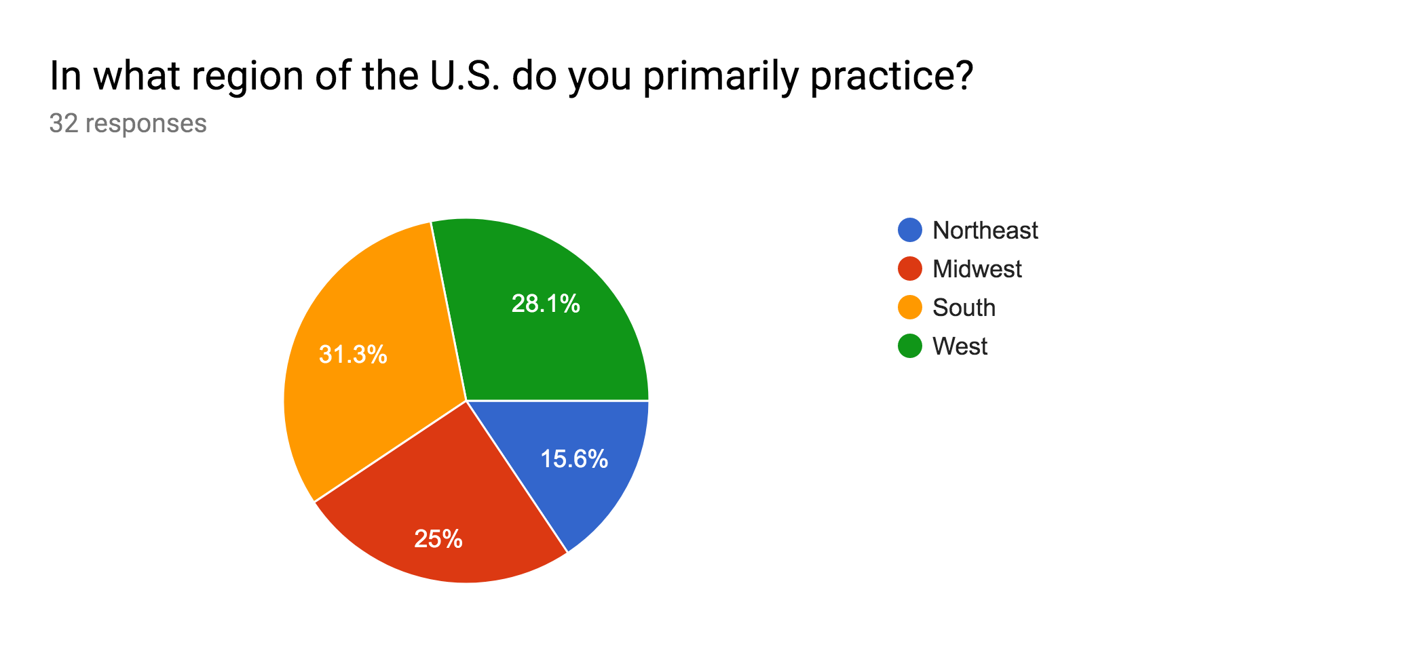

Slide 28
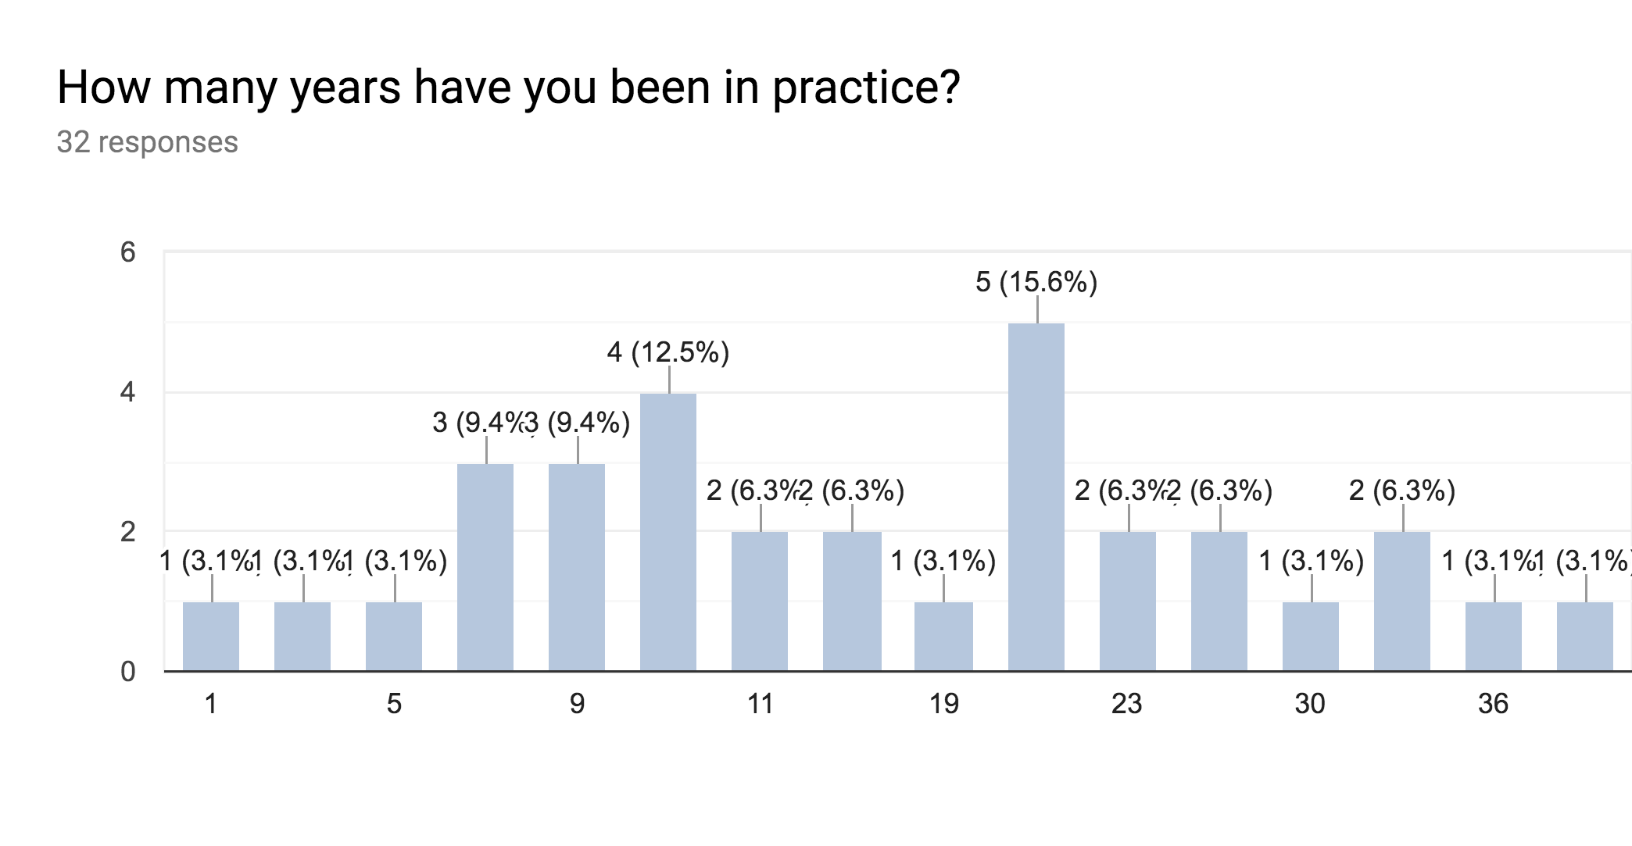
28% (<10 years)
28% (10-20 years)
31% (20-30 years)
13% (>30 years)

Slide 33
CSM Res/Fellowship Courses:
Wednesday
8:00-5:00pm: Beyond the Basics: Design and Implementation of Best Practice in Residency and Fellowship Clinical Education (Ortho)
Thursday:
8:00-10:00am: Mentorship: Concepts and Application in Physical Therapy Residency and Fellowship Training Programs (Education)
11:00-1:00pm: Does Residency and/or Fellowship Training Impact Job and Career Satisfaction in Physical Therapists?
11:00-1:00pm A Clinical Reasoning Blueprint: Linking Learning Theories to Curricular Innovations (Education)
3:00-5:00pm: Exploring the Value of Residency/Fellowship Education: Stakeholders’ Views on Why Residency/Fellowship Education Matters (Education)
Friday
8:00-10:00am Investing in the Academic Future of Physical Therapy Learners: The Resident Educator (Education)
3:00-5:00pm The Value of Post-Professional Residency, Fellowship, and PhD Training (Research)
Saturday
8:00-10:00 Leveraging Residency Program Mentoring Methods to Improve Transdisciplinary Professional Development, Engagement, and Retention

Slide 34
CSM Res/Fellowship Posters/Presentations:
Friday
11:00-1:00pm VA PT Resident Case Presentations
1:00-3:00pm: Factors Influencing the Decision to Apply to a Postprofessional Physical Therapist Residency Program
1:00-3:00pm: Program Characteristics Influencing Application to a Physical Therapist Postprofessional Residency Program
1:00-3:00pm: Does Residency and/or Fellowship Training Impact Professional Engagement?
1:00-3:00pm: Do Entry-Level Physical Therapy Programs Prepare Students for Post-Graduate Residency Education?
1:00-3:00pm Leadership Behaviors and Goals of Physical Therapists in an Fellowship Orthopaedic Manual Physical Therapy Program
3:00-5:00pm American Academy of Sports Physical Therapy Residency Research Platform Presentations
Saturday
1:00-3:00pm Connection between Residency and a “Culture of Excellence” in a Highly Specialized Area of Rehabilitation

Slide 35
CSM Res/Fellowship Meetings
Thursday:
10:00-11:00 am: Oncologic Residency Work Group Meeting
11:00-Noon: Geriatrics Residency and Fellowship Meeting
4:00-7:00 pm ED-RFSIG Meeting
Friday:
3:30-5:00pm Oncology PT Residency/ Specialization Applicant Meeting
6:30-7:30am: Neuro Residency and Fellowship Networking Breakfast: *Invitation Only* Contact Ali Carlson at info@neuropt.org to attend
Saturday
7:00-7:45 am: AOPT ORF-SIG Business Meeting
1:00-1:50 pm: AASPT Residency and Fellowship SIG Business Meetings

Slide 36
Practice/Reimbursement Committee: -Darren Calley
Committee Goals/Strategies:
• Survey current programs about innovative mentoring strategies and environments by 2020.
• Review and disseminate current research and existing resources on mentoring best practices by March 2020.
• Provide educational webinars and resources for the mentorship and development of mentors and faculty by 2021.
• Identify and address gaps in current research regarding effective mentorship practice by 2022.
• Create and distribute a mentoring resource by 2022.

Slide 37
RFESIG Initiatives
Liaison: Christina Gomez
R/F Director Mentoring Program
Purpose: To support the RFESIG membership in their goal to excel as educators and program directors by pairing experienced and novice R/F Directors and/or Coordinators.
Goal: To foster support, feedback and guidance throughout the year and allow for open dialogue about specialized topics.
Plan: Meet-and-Greet at Combined Sections Meeting
Contact: Christina Gomez at cgomezpt@gmail.com for more information.

Slide 38
RFESIG Initiatives
RFESIG’s First Podcast
The RFESIG interviews Linda Csiza about ABPTRFE’s Annual Continuous Improvement Report
Questions answered include:
What is the difference between exhibit 2 and exhibit 3?
What are substantive changes?
How can I make my program goals measurable?
Contact: Christina Gomez at cgomezpt@gmail.com for the link to the podcast.

Slide 40
ORF-SIG and AAOMPT collaboration
AAOMPT Membership Chair interested in promoting their Early Professionals SIG and may participate in Residency/Fellowship Career Reception at CSM
AAOMPT ACF SIG leadership interested in possible collaboration with ORF-SIG. They will be meeting in a couple of weeks so more discussion forthcoming.

Slide 41
Open Floor

Slide 42
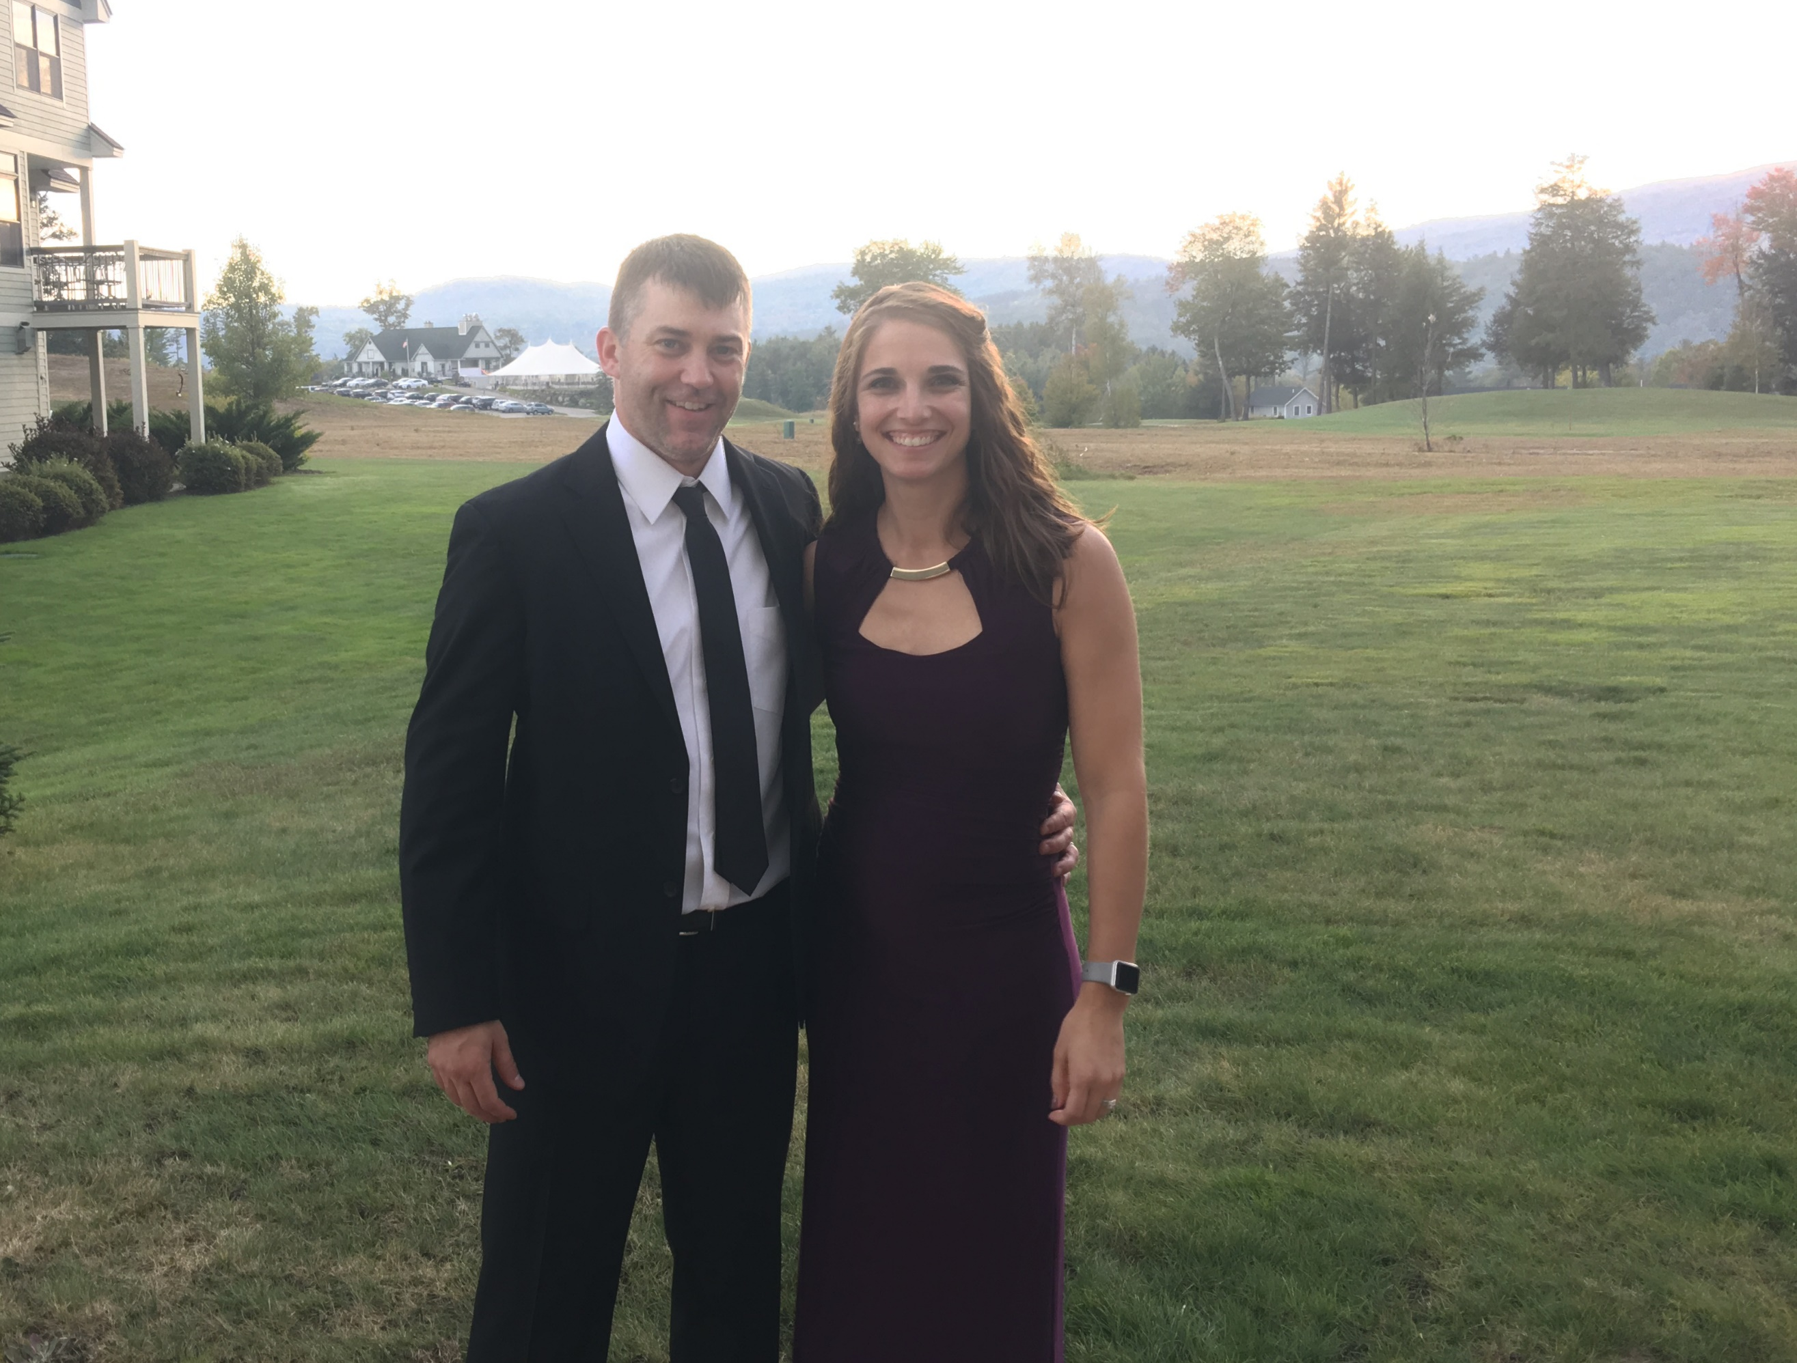
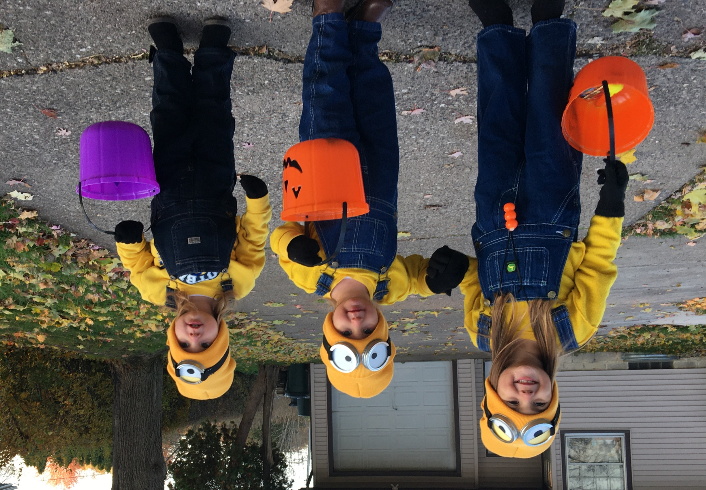
Thank You!
Don’t forget next SIG meeting
CSM, Denver:
February 15th 7am

